Slide 1
Legal Status Tracking Workflow
Zoom Trainings
09.12.24
09.19.24

Slide 2
Intro
Share CalMHSA's recommendations for tracking legal statuses and holds within the EHR.
To support DHS requirements for BHIN: 23-067, 24-011, & 24-013 LPS Quarterly Data Collection
Design and Product Team
Sabrina Caraveo: Inpatient Implementation Specialist
Delphine Huang: Medical Director, Innovation and Design
Matthew Thombs: Sr. Project Manager
Peter Merna, Reports and Implementation

Slide 3
Agenda
How to Error Out a Legal Status Order
View List Page of all Legal Status's placed
Legal Status Report for Clinical Use
Status BHIN Report
Resource Material
Future State
Questions
Why Track in Client Orders for Legal Status
Roles / Permissions
Demographics required for Legal Status
How to Create a Legal Status Order
What to do if you have no prescriber to add
How to view the Legal Status Order on the Whiteboard
How to change the Legal Status Order
How to Modify / Add Additional Information
How to Discontinue the Legal Status Order
How to Complete the Legal Status Order

Slide 4
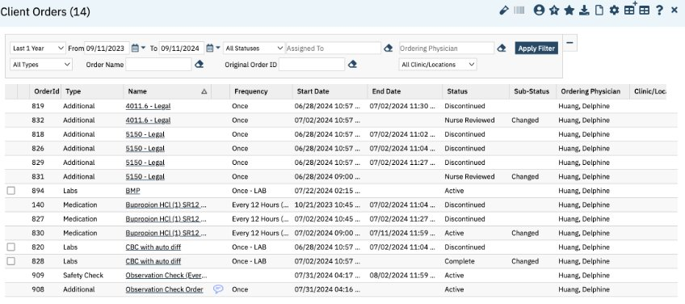
Why Track in Client Orders
Why we chose to use Client Orders as the function to capture:
Can track date/time
Standardize method and fields.
Uses familiar screen to most counties
CDAG based: So only programs within a CDAG will be able to see the orders on Client Orders List Page.
Flows from outpatient (eg Mobile Crisis) to inpatient/CSU units in a centralized location, and IP/CSUs can use their whiteboard.
Connects to exportable / filterable list pages.
Create clinical and BHIN-related reports to capture cumulative data.

Slide 5
Roles and Permissions
Granting Role and Permissions to individual staff will need to be completed by County System Administrators.
These clinical roles automatically have access to client orders:
Prescriber
Prescriber IP/CSU/Res
Nurse IP/CSU/Res
This role is only if base role is none of the above, but needs to be able to input legal status in client orders:
Orders-Add On
Understand that end users with these roles, will be able to see all client order types, including legal statuses.

Slide 6
Demographics required for legal status
Need to complete to meet BHIN report's collected demographics :
Age
Sex
Gender Identity
Sexual Orientation
Race
Ethnicity
Housing Status
Veteran Status
Primary Language
Article: https://2023.calmhsa.org/how-to-complete-legal-status-demographics-documentation/

Slide 7
Available Legal Hold Code Names

Slide 8
Create a New Legal Status Hold Order
Create a new client order by going to Client Orders Screen, which will take you to the Client Order List Page with all orders.
Click on the "New" icon on the upper right corner.

Slide 9
Create a New Legal Status Hold Order
Three ways to search for Legal Status Order in the Order Search bar
Search by legal status code name ( eg.5150)
Search by the word: "Legal"
Look by orderset tab, "Legal statuses" for all of the choices.
Can add legal status order to your Preferences, if desired.
The order which is the legal status code name will automatically show up in the WhiteBoard's Observation column.
You should pick the legal reason under "Legal". This will then show under the Whiteboard's Legal column.
Ensure that you have selected the start time to reflect the start of the hold or can be the start of the order.
Ensure that you have selected the End date/time to reflect the maximum length of the hold.
Fill out any applicable questions.
Click "Insert"
Click "Sign" to finalize the order.

Slide 10
If you have no prescribing provider and you are ordering a legal status
If you are a clinician or social worker who is placing the legal status, and there is no "ordering physician," they can choose "N.A. Provider" to allow for this order to have mandatory fields completed.

Slide 11
Viewing legal status order on the whiteboard
Legal Status Name Code will populate under the Observations column
Legal Reason will populate populates under the Legal Status Column
To remove this, you must either complete or discontinue order.
To add a new Legal Status under these columns, a new order must be placed.

Slide 12
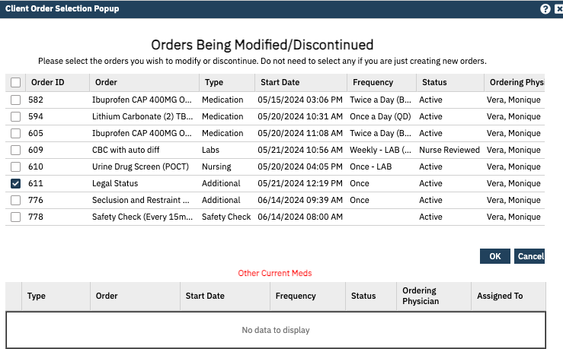
Changing an existing order to a different legal status
You MUST do this through the Client Orders (Client) screen
Select your order to modify by adding checkmark.

Slide 13
Changing an existing order to a different legal status
Click the radio button in the order list to get your order to populate
Edit any information you need to
This will discontinue the previous version of the order and create a new PDF with your name, time stamp.
The PDF of the previous version will still exist in the Client Documents

Slide 14
Add supplemental information to the questions
These questions are used to help capture DHCS request for certain data, as well as, clinical data to help teams keep track of what is happening during the hold.
The questions may be answered at different times of the hold. Each time the same order should be modified.
Each modification is timestamped to capture when information is added on the backend.
Keyphrase functionality works as well on this screen if text templates are desired.

Slide 15
Questions to capture more information about hold
Questions to answer when creating the order: 1. If Grave Disability was selected under Legal Status, then must answer #1 about reason for the Grave Disability.
2. Can record person/position that placed the hold if different than the order author/ordering physician (eg. Police)
3. Can select location that hold was initiated (eg ED)
4. When was the hold initiated is to capture when the hold started if it is different than the Start Date/Time of the order.
Questions to answer during the hold
5. Review/Hearing Scheduled: can capture this information for other team members to be aware
6. Disposition: is to record if any decisions were made to maintain or discontinue a hold
7. Hold Disposition Authorized by: is to record who made the disposition decision
8. Disposition Date/Time
9 Legal Status Comments:
10 Error: if order is entered in error

Slide 16
"Complete" Legal Status Order
Use "Complete" when the legal hold has met its maximum time.
The End Date/Time should NOT need to be changed if it was selected appropriately when order was made.
You MUST do this through the Client Orders (Client) screen.
Select the original order to modify.
Click the radio button in the order list to get your order to populate.
Click Status Drop - Down Menu
Select "Complete"
Click "Insert"
Click "Sign" to complete order.
This legal status will now "Complete"

Slide 17
"Discontinue" Legal Status Order
This should only be done when the hold ended EARLIER THAN MAXIMUM HOLD TIME. The end date / time should be changed to reflect the change in time OR #Q8 Disposition Time/Date.
You MUST do this through the Client Orders (Client) screen
Select your order to modify
Click the radio button in the order list to get your order to populate
Click the discontinue checkbox
This will change the end time to right now
Click Insert
Sign
This will discontinue the previous version of the order and create a new PDF with your name, time stamp.

Slide 18
How to error a legal status order
Use this if the legal status was placed accidentally and needs to be errored.
This is important because for the various reports, that order will NOT be included.

Slide 19
View legal statuses through Orders List Page
This view can be helpful when you want to see all active legal statuses
This will be done through Orders (My Office) screen
Select Order type: Additional
You can type in Legal to see ALL legal status orders
You can also type in the code, ex: 5250, to see ALL 5250 orders.
You can toggle between active, discontinued, completed orders.
Filter using the dates
Page can be exported.

Slide 20
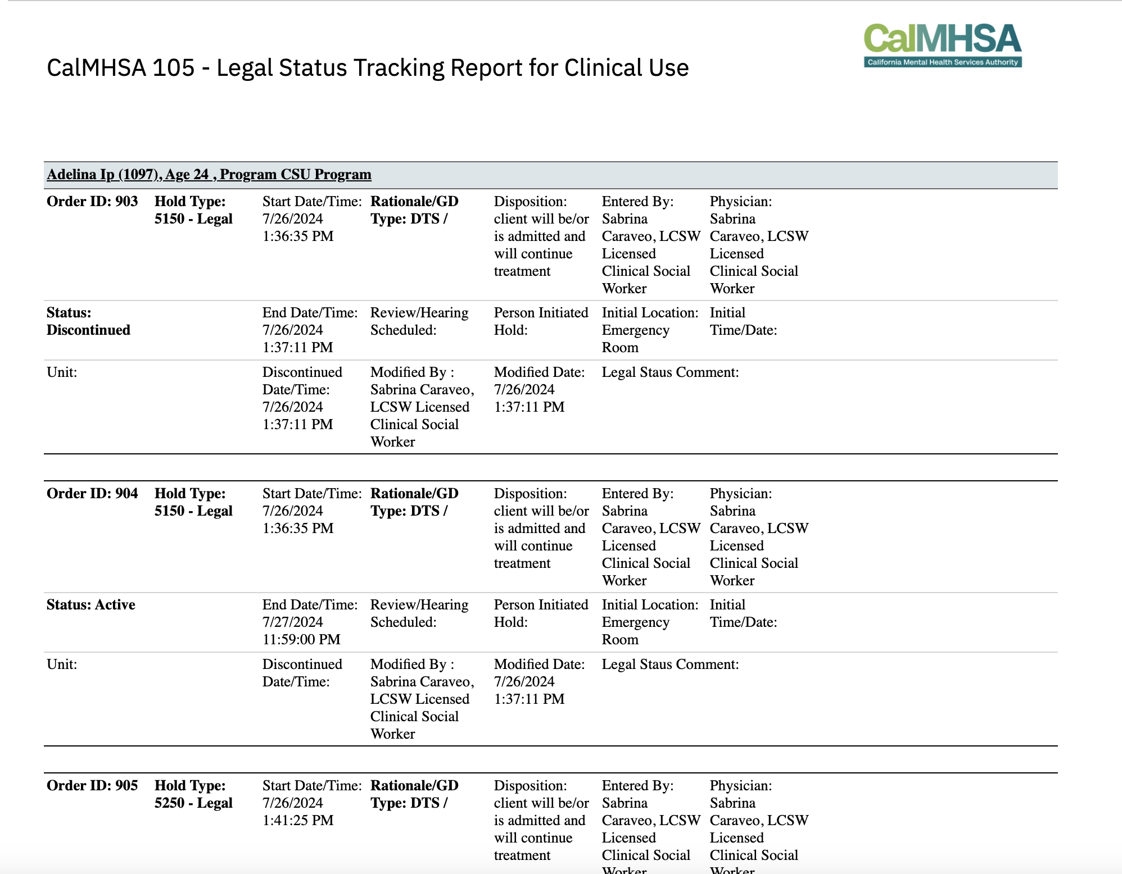
Legal Status Report for Clinical Use
This report is to aid providers to be able to cumulatively see what legal holds a client(s) currently is on, and in the past. This information can help teams be able to quickly compile the Legal Status Orders at a client level into one report to facilitate review. It also tracks when the hold was placed and then the status of the hold. It also captures any of the responses/answers for the questions in the Legal Status Order.
This report is available for the following clinical roles:
Prescriber
Prescriber IP/CSU/Res
Medical Supervisor
Clinician Supervisor
Orders Add-On
Can find this report by searching for:
CalMHSA 105- Legal Hold Tracking for Clinical Use (My Office).
How do use the report: CalMHSA 105 – Legal Hold Tracking Report for Clinical Use (My Office) - 2023 CalMHSA

Slide 21
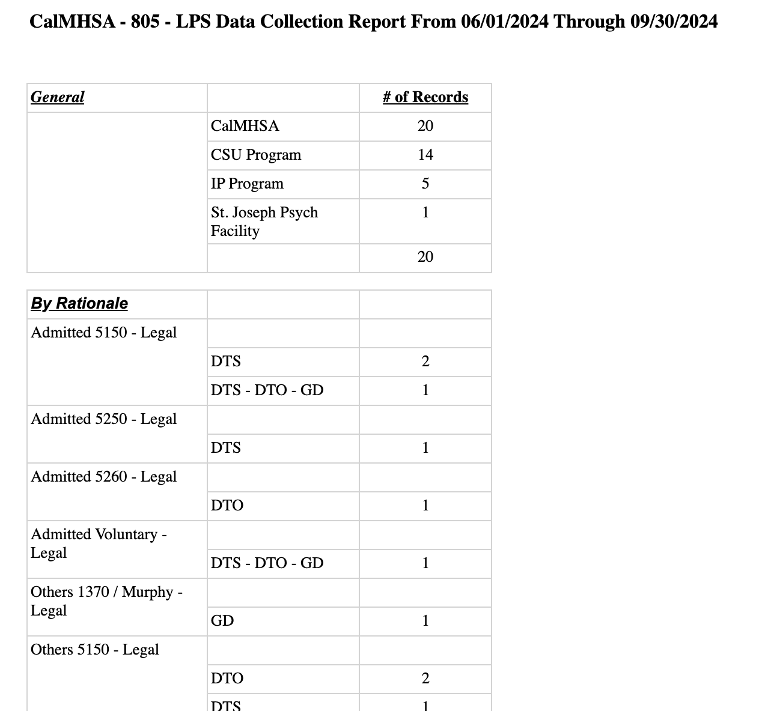
Legal Status for State Report
To support counties that are reporting for BHIN24-013, we have created a report for documented legal statuses within the EHR. This data is at a county level.
Please note that this data can aid users in filling out the state report but is only reflective of what is captured within the EHR. Your county may need to include other sources to be comprehensive.
The following roles have access to this report
County Affiliate Sys Admin
Medical Records/QI
Clinical Supervisor
Medical Supervisor
Search for: CalMHSA 805- LPS Data Collection Report (My Office).How to read the report: CalMHSA 805-LPS Data Collection Report/DHCS Legal Status - 2023 CalMHSA

Slide 22
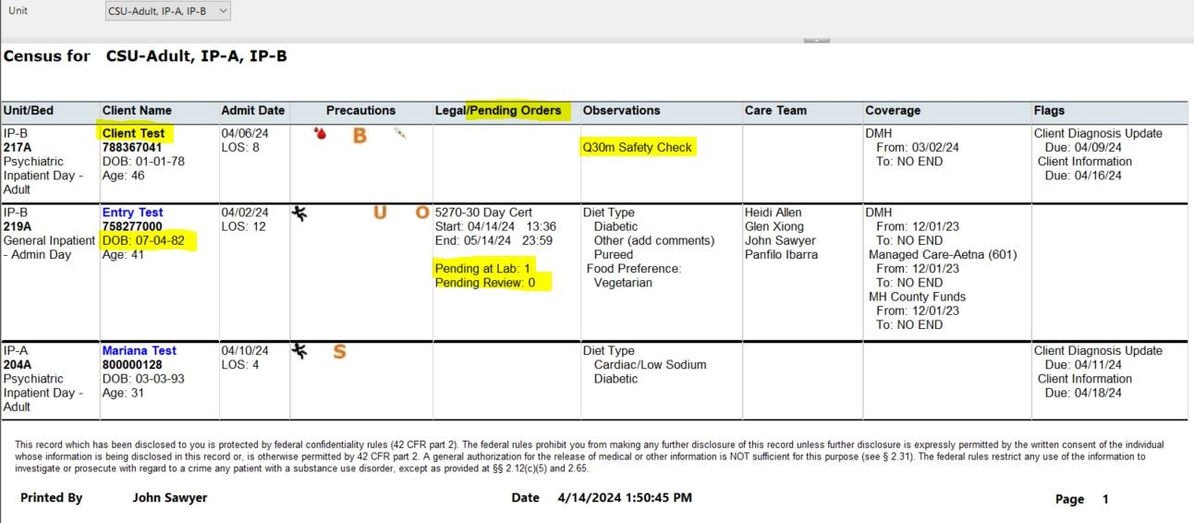
Future Builds
CalMHSA Shift/Rounding Report- Coming Soon!
For IP/CSU/Res Units that use Whiteboard, there will be an expanded shift report that will include legal status.
Future Development:
Digitalizing 1801, 1802, 1808, 1809 Forms for Involuntary Holds

Slide 23
Legal status resource materialS
Completing required legal status / hold demographics | How to Complete Legal Status Demographics Documentation - 2023 CalMHSA
Creating a Hold / Legal Status Order | How to Create & Document a Client Hold - 2023 CalMHSA
Viewing Legal Status / Hold Order on Whiteboard | How to View the Client's Legal Status from the Whiteboard - 2023 CalMHSA
View All Legal Statuses / Holds for Facility | How to View Legal Status in Orders (My Office) - 2023 CalMHSA
Modify or update information on Legal Status Hold | How to Update a Legal Status Order - 2023 CalMHSA
Complete / Discontinue Legal Status Hold | How to Remove Legal Status Once it is Completed - 2023 CalMHSA
Legal Status Report for Clinical Use | CalMHSA 105 – Legal Hold Tracking Report for Clinical Use (My Office) - 2023 CalMHSA
LPS Data Collection Report/ DHCS Legal Status | CalMHSA 805-LPS Data Collection Report/DHCS Legal Status - 2023 CalMHSA

