Slide 2
New Rates and Billing Code Testing
Scenarios to test at minimum for New Rate and Billing Code Configurations for 7/1/2024
Mental Health
Individual Therapy (choose your staff/degree for rate calculation)
10 minute duration – Should result in $0.00 and NOMIN
20 minute duration – should result in rate calculation and 90832/1 unit
40 minute duration – should result in rate calculation and 90834/1 unit
60 minute duration – should result in rate calculation and 90837/1 unit
68 minute duration – should result in rate calculation (per 15 min) and T2021/5 units
100 minute duration – should result in rate calculation (per 15 min) and T2021/7 units
Mental Health or Substance Abuse
Assessment LPHA
15 minute duration – should result in $0.00 and NOMIN
50 minute duration – should result in rate calculation and 90791/1 unit

Slide 3
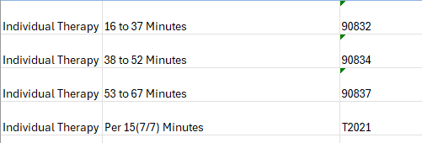
New Rates and Billing Codes
T2021 and T2024 explained for 7/1/2024
T2021 & T2024 requires a minimum of 5 units to bill

Slide 4
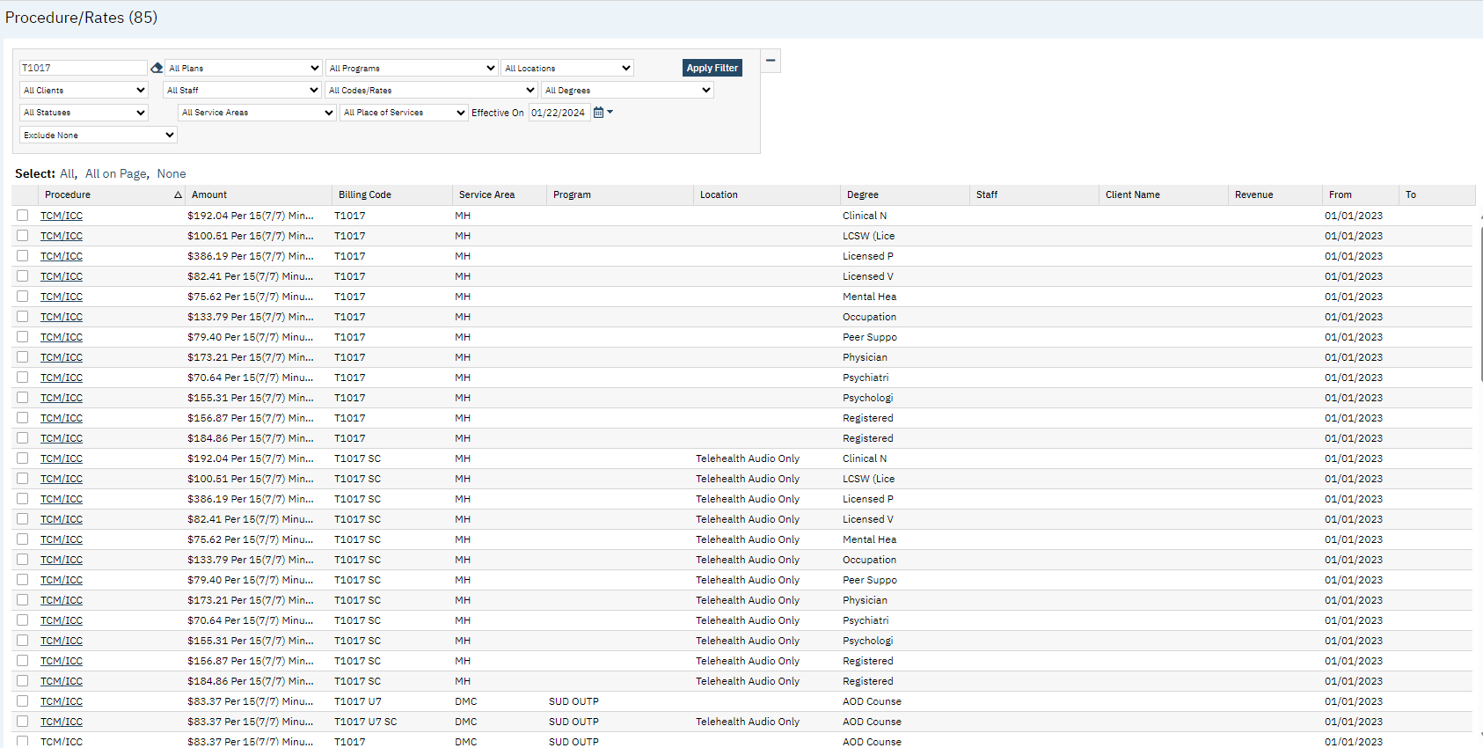
Billing Office Hours
Procedure Rates - BEFORE
Mutiple rate rows by
Service Area
Program
Location
Degree
More to manage

Slide 5
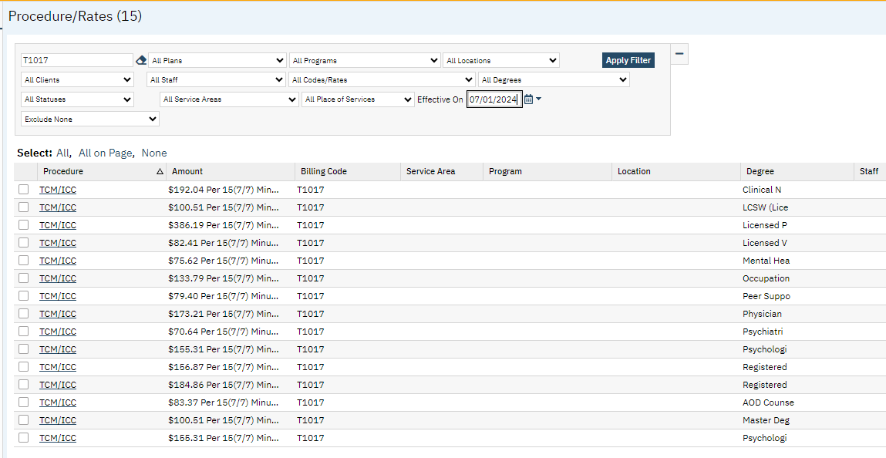
Billing Office Hours
Procedure Rates - AFTER
Only rows needed to calculate the rate by
Program (SUD Residential)
Degree
More accurate rate calculations
Less to manage

Slide 6
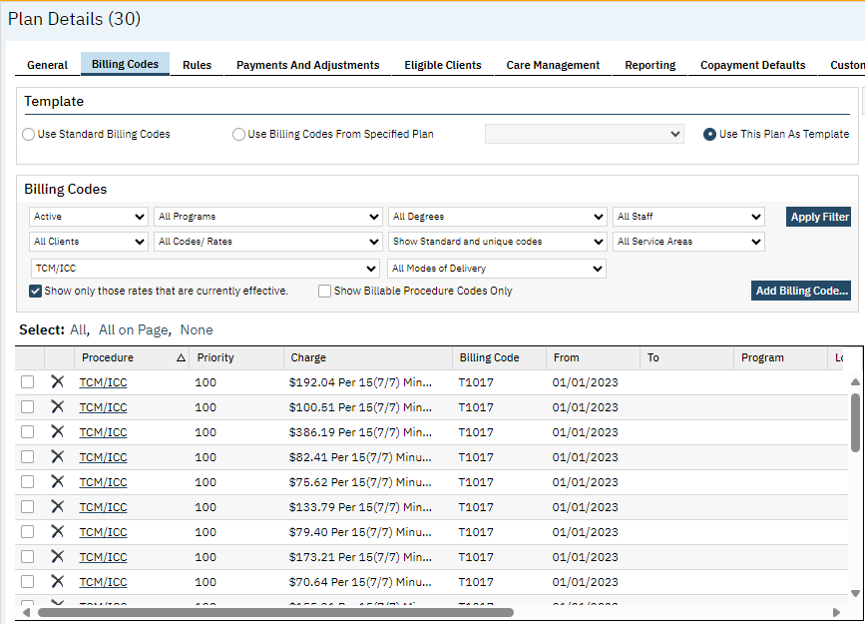
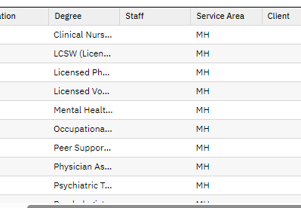
Billing Office Hours
Billing Codes & Modifiers on the Plan - BEFORE
Un-necessary combinations on the plan (ie: invalid modifiers or rows for degree)
Missing combinations
More to manage

Slide 7
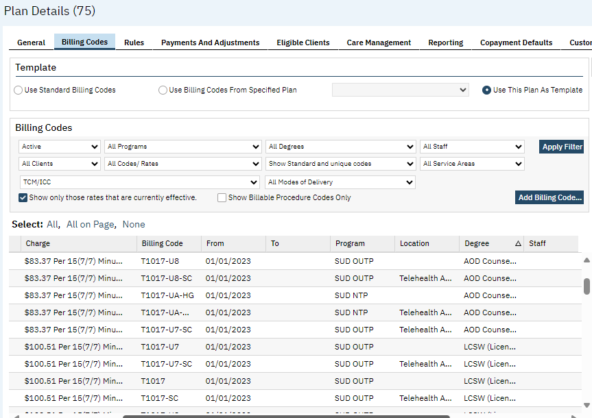
Billing Office Hours
DMC Plan - Before

Slide 8
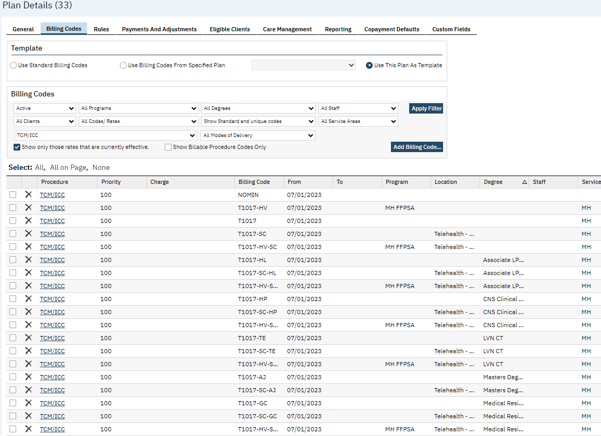
Billing Office Hours
DMH Plan Example
Procedure Billing Codes & Modifiers - AFTER
Only rows needed to calculate the billing code & modifiers
Program
Service Area
Location
Degree
Funding Source
More accurate calculations
Less to manage

Slide 9
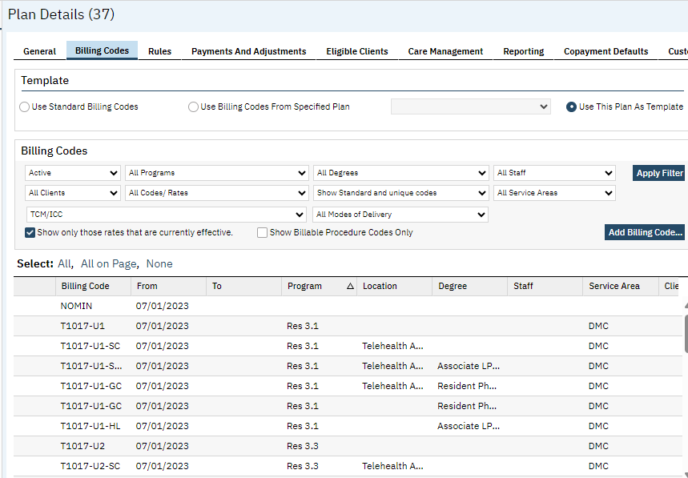
Billing Office Hours
DMC Plan Example
Only rows needed to calculate the billing code & modifiers
Program
Service Area
Location
Degree
Level of Care
More accurate calculations
Less to manage

Slide 10
Billing Office Hours

