Slide 1
Stages of a claim and erroring out when a service was added to wrong account

Slide 2
Stage 1: Service entry (no charge made)
If you are entering a service manually, and you realize.. oops…. Wrong account!
Just click on the little X on the top right of your screen.

Slide 3
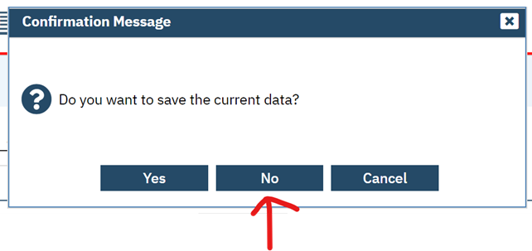
A confirmation message pop-up shows up asking if you want to save current data?
Click NO.

Slide 4
If you have saved the erroneous service, and you realize.. Man! that doesn’t belong there!...the status is still in “show” Just click on the DOS that is wrong and then click on the little garbage can on the top of your screen.

Slide 5
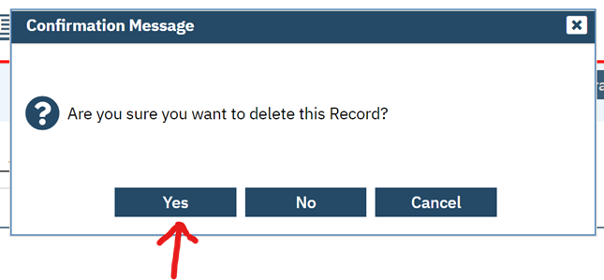
A confirmation message pop-up shows up asking if you want to delete this record?
Click YES.

Slide 6
Stage 2: Service has a charge and is in “complete” status

Slide 7
From the Services (client) screen…
Click on the DOS that is erroneous

Slide 8
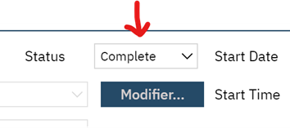
At the top middle of the service box you will see a “status” section with the word “complete” with a drop down menu.
You will also notice that your “save button” is greyed out

Slide 9
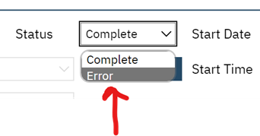
Click the little arrow next to the word complete and you will see one added word “error”.
Click on “error”.

Slide 10
The system will process your request, then you will notice that the Save button is now dark and ready to be used. Click “SAVE” and then the X next to it to close this screen.

Slide 11
You will now notice on the Services (client) screen that the service is now Errored out and has a $0.00 charge to it.

Slide 12
Stage 3: Service has been billed out (claimed)
Enter the client name that has the erroneous services. By clicking on the little blue guy at the top of the screen.
Type in client name
2) Click on the search icon (magnifying glass) to the left
Type in the “Services (client)”

Slide 13
From the Services (client) screen, locate the service in question…
Repeat the same steps as you would for “Stage 2” Service has a charge and is in “complete” status.

Slide 14
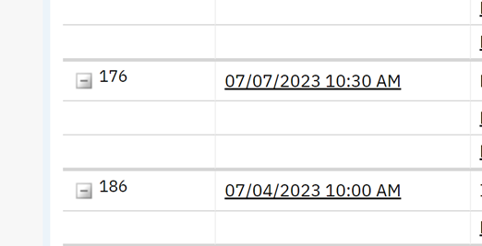
Here is the claim on the Service (client) screen after erroring out.
You will see on the client account screen, the service is NOT showing up. (DOS 7/6/23)

Slide 15
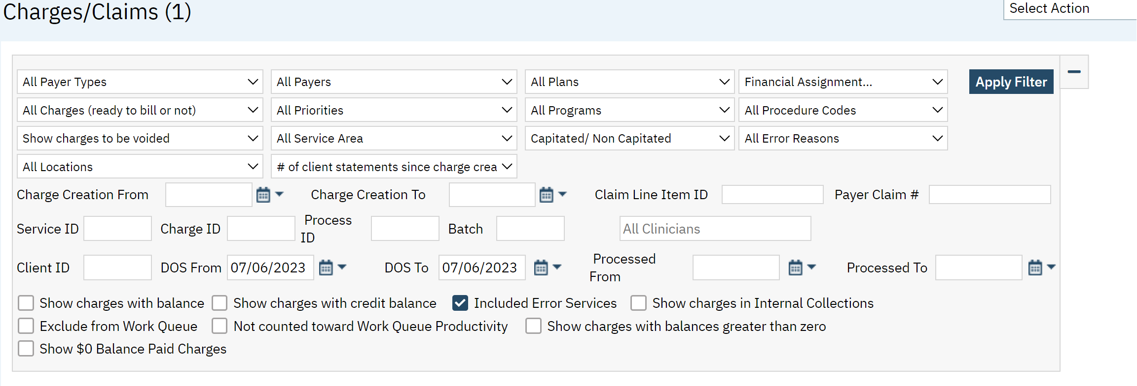
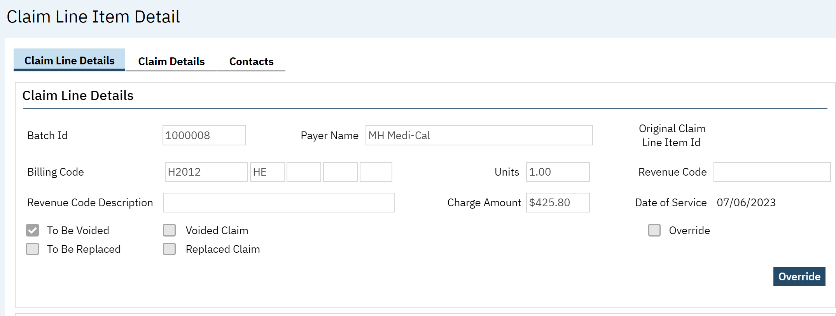
On the charges/claims screen; using these filters, you will be able to see the errored out billed claim. (note: the most important is the check box for “Included Error Services”) then apply your filter.
Clicking on the hyperlinked 1 on the service line, will pull up the Claim line Item Detail screen. Here you will see the claim to be voided in detail.

Slide 16
As you saw on the previous screen, the errored-out claims were checked “to be voided”. To fully have the claim be voided in the system AND the State’s system, you will have to bill an “errors” claim file. This file will have any and all errored-out service(s) that have been billed to the State and errored in the system. Once the errored-out claim(s) have been billed, then the system marks those claims as “voided claim(s)” . When you pull the claim file, you will notice a different claim status for the claim file. (B:1 for normal claims vs. B:8 for voided claims)

