Slide 1
Billing Session

Slide 2
Agenda
CalAIM Same Day Billing Rule
Service Error Report (s)
Configuring SmartCare for New Programs
Q&A

Slide 3
Same Day Service

Slide 4
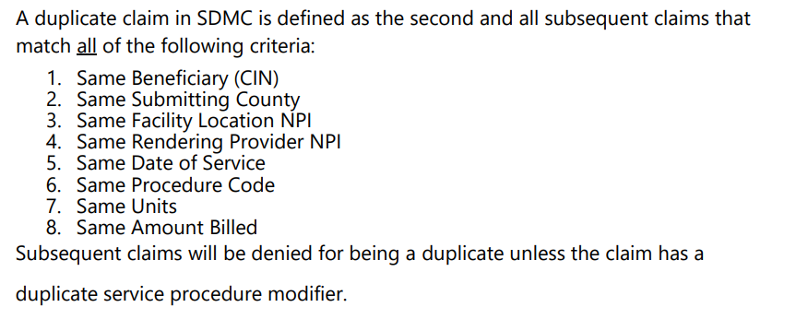
Short Doyle Rule – Duplicate Services

Slide 5
New CalAIM Rule – Same Day Service

Slide 6
New CalAIM Rule – Same Day Service

Slide 7
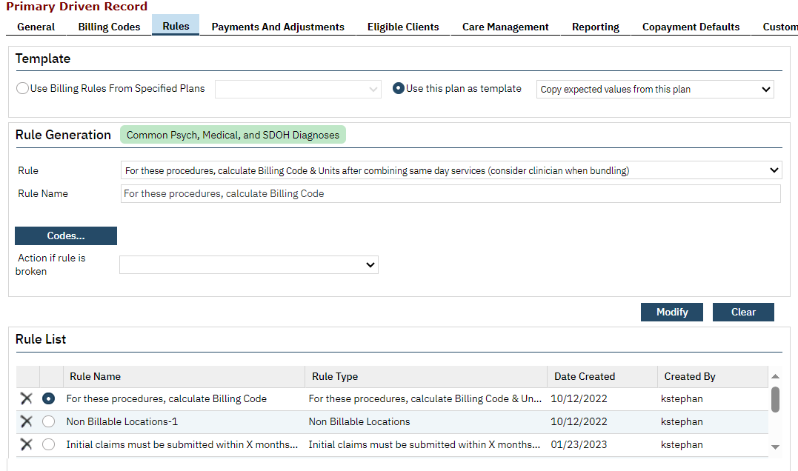
New CalAIM Rule – Same Day Service

Slide 8
New CalAIM Rule – Same Day Service
A Client Has Two, 20 Minute Visits
What would Happen?
A Client Has One 20 Minute Visit, and One 15 Minute Visit
What Would Happen?

Slide 9
New CalAIM Rule – Problem
This rule is a Medi-Cal only rule. So, while Medi-Cal wants us to combine the two 99213s together, if there is a payor that is primary to Medi-Cal, they may not have this same requirements.
This means that the calculation to combine the two charges together ONLY gets applied when we are beginning the process to produce claims for Medi-Cal
There are issues related to how the Charges appear on the system’s Ledger.
We need to have each Service remain (each has a note that needs to be part of the medical record),
We need to have the separate Charges remain (we might need to bill these separate charges to a primary plan)

Slide 10
New CalAIM Rule – Same Day Service
This means that the calculation to combine the two charges together ONLY gets applied when we are beginning the process to produce claims for Medi-Cal
This requirement presents issues related to the sequence of events.
For the system to perform this calculation, it presumes both service records are entered into the system without fail for the system to make the connection between the two occurring on the Same Day
Contractor Invoicing occurs before the calculation of Medi-Cal Claims. So, the services entered by contractors will result in two initial charges (99213). How are they supposed to present/invoice those to the County?

Slide 11
Same Day Service – Problem?
For Billing to Medi-Cal – No
Assuming that Both Services are Entered Before the Claims Are Created
For Contractor Invoicing - Kind Of
Currently, this requirement will result in Over-Payment to Contractors as Their Services will NOT be combined.
As we saw, the Net Amount of the Two Service will Sometimes exceed the value of a combined service
CalMHSA is working on developing reconciliation processes/report to address these overpayments

Slide 12
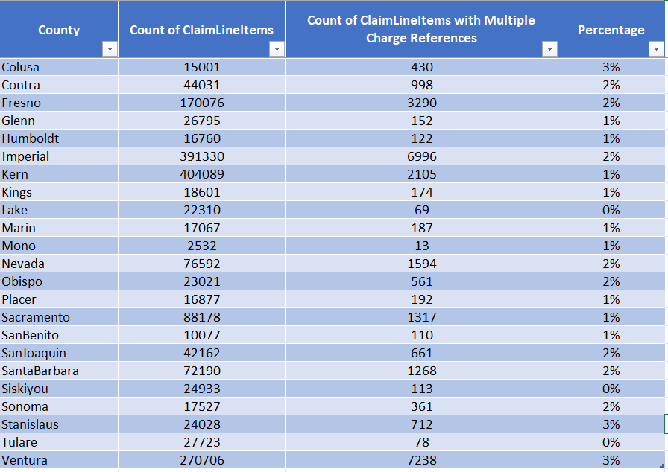
The Numbers

Slide 13
Diagnosis Billing Errors

Slide 14
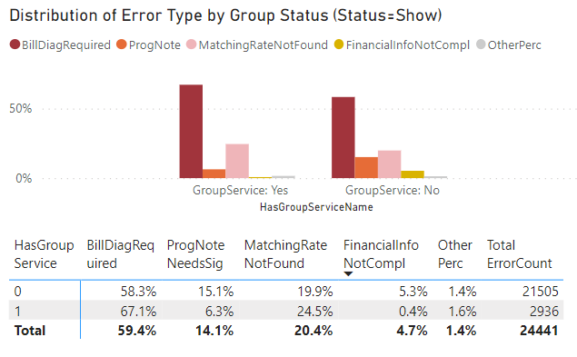
Diagnosis Errors – Problem?
Yes – Billing Diagnosis Errors Account for 59.4% of Service Errors

Slide 15
Diagnosis Errors – How Can I Address?
There is a new report in all County PROD Systems called “CalMHSA Billing Diagnosis Errors Report”
It has been assigned to user roles
County Affiliate SysAdmin
LPHA/Clinician
Clinician Supervisor
Reception and Front Desk
Medical Records/Quality Assurance
Billing Supervisor
Billing
Medical Supervisor

Slide 16
CalMHSA Billing Diagnosis Errors Report
Yes – Billing Diagnosis Errors Account for 59.4% of Service Errors

Slide 17
CalMHSA Billing Diagnosis Errors Report
Report will categorize and group the errors into the following use cases:
Use Case 1 – There are no Diagnosis Documents with the same “Program” that correspond to the “Service Program”
Use Case #2 there IS a Diagnosis Document with the same “Program” that corresponds to the “Service Program”, but the “Effective Date” of the Diagnosis Document is before the “Date of Service”
Use Case #3 There IS a Diagnosis Document with the same “Program” that corresponds to the “Service Program”, and the “Effective Date” of the Diagnosis Document covers the “Date of Service”, but the “Status” of the document is not “Signed”

Slide 18
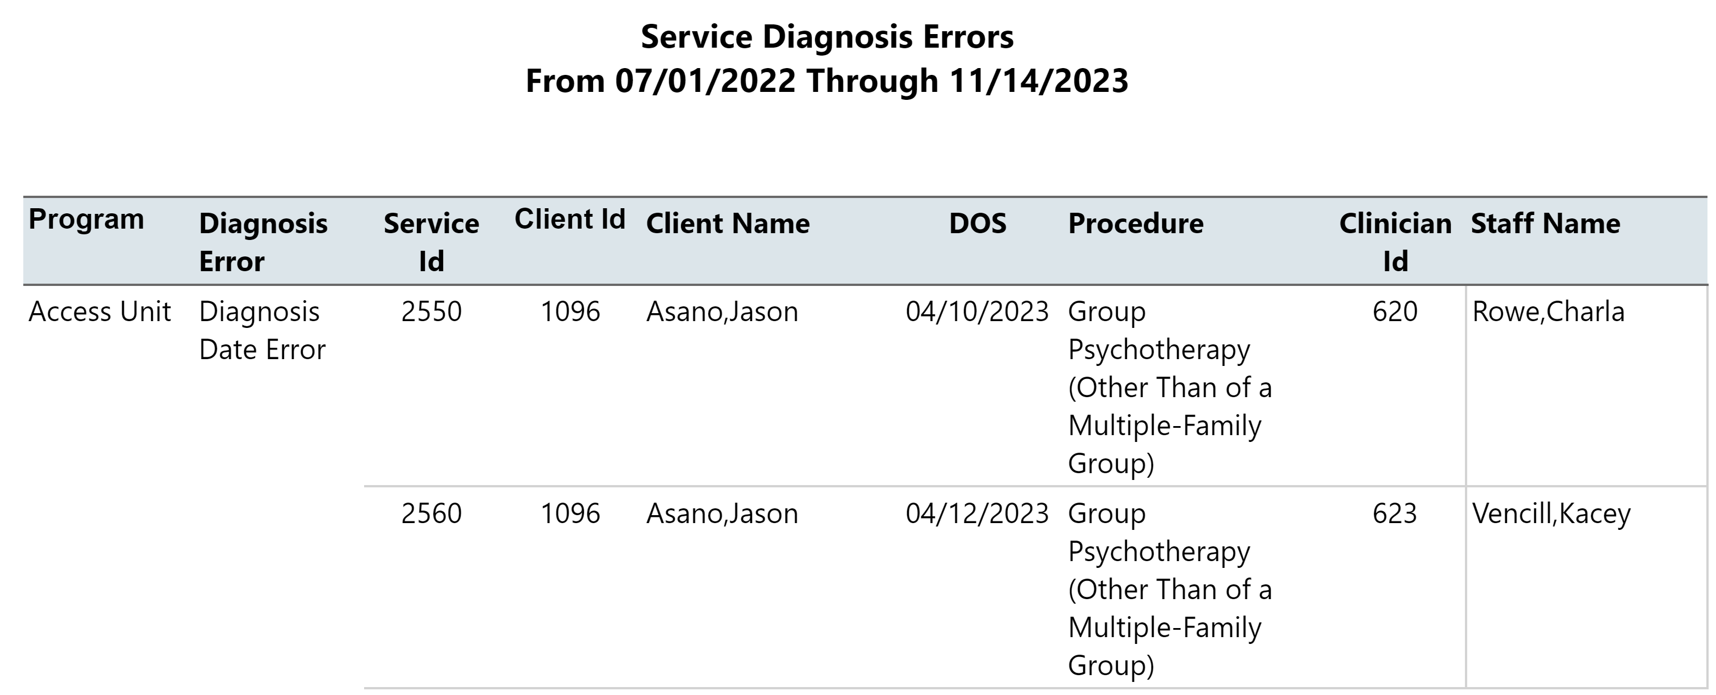
CalMHSA Billing Diagnosis Errors Report

Slide 19
Configuring SmartCare for New Programs

Slide 20
Agenda
Program Setup
Items to Setup and Consider
Program Name (Naming Convention)
Procedure Codes
Locations
Clinical Data Access Grouping (CDAG)
Staff/Users
TEDS Setup – State Reporting
274
Rates & Billing Codes
Claim Formats/Billing Claims Override
Financial Assignments
Q&A

Slide 21
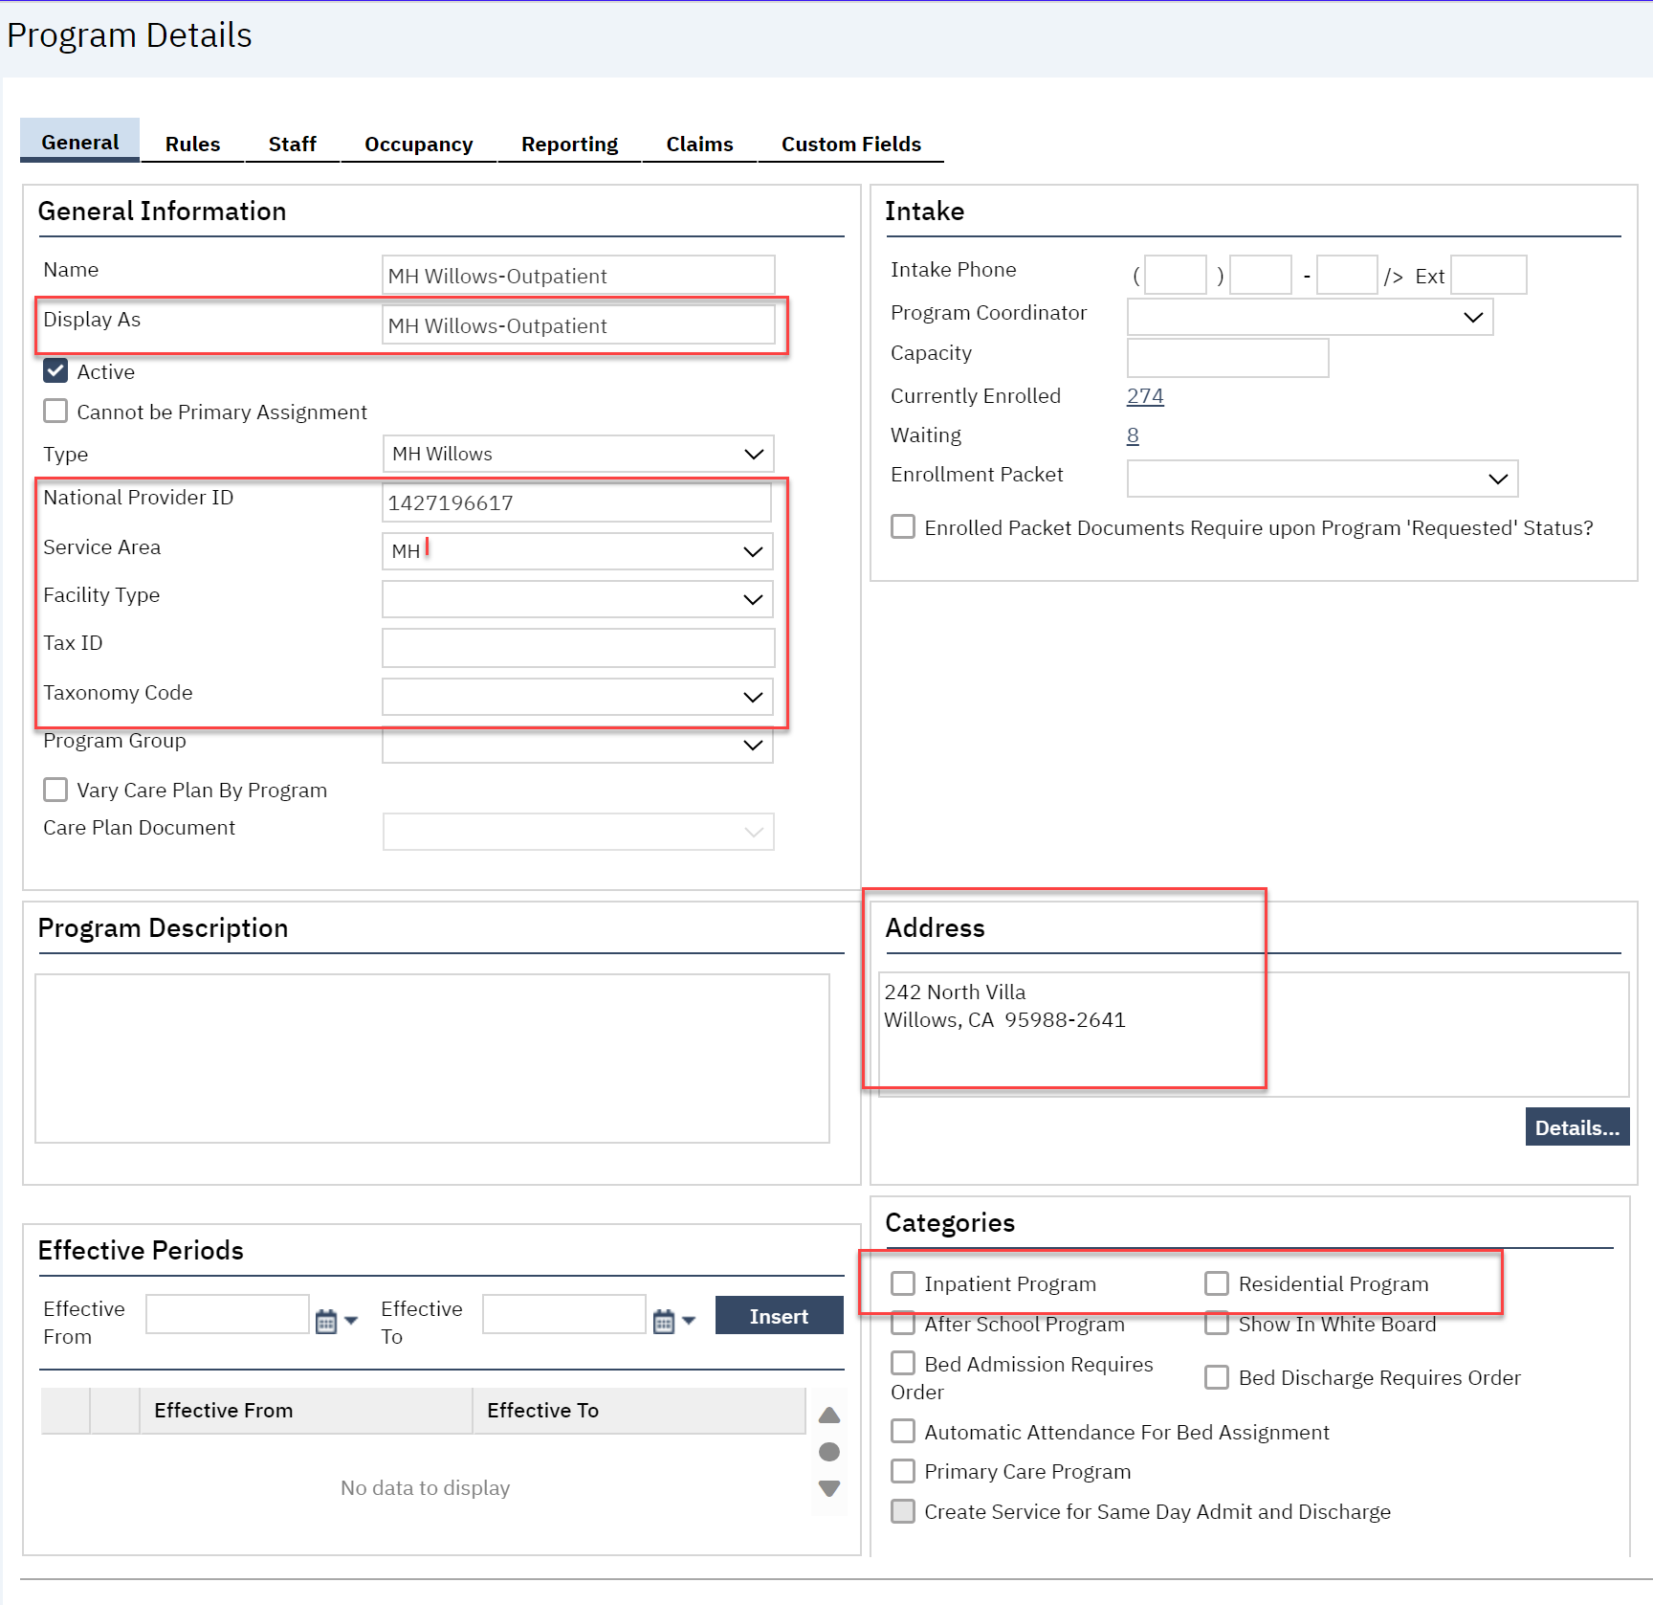
Program Details
Program Display Name
NPI
Service Area
Facility Type
Tax ID
Taxonomy Code
Address (9 digit zipcode)
Categories
Notes:
The important point here is that the complexity of information notices is very different grounded in essential measurable changes in the EMR. Eg network adequacy.

Slide 22
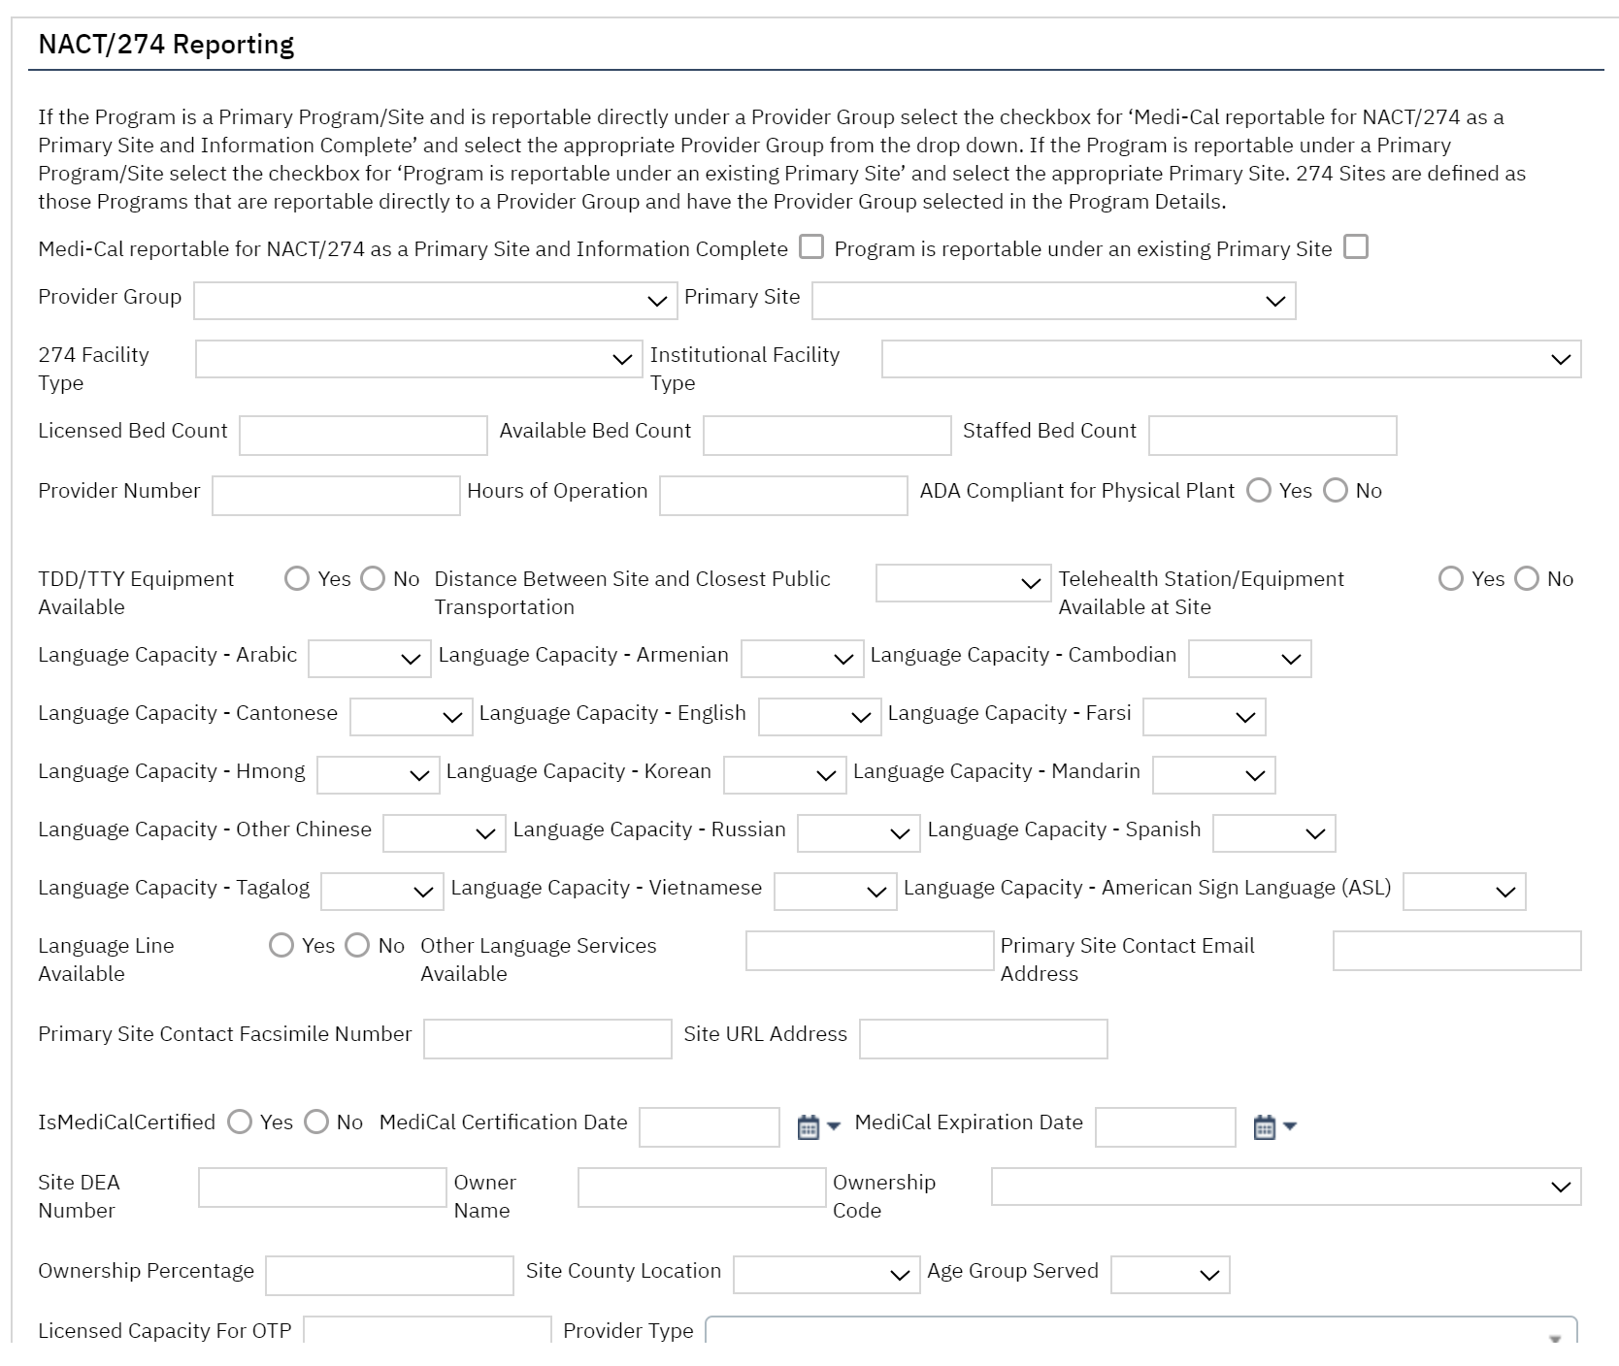
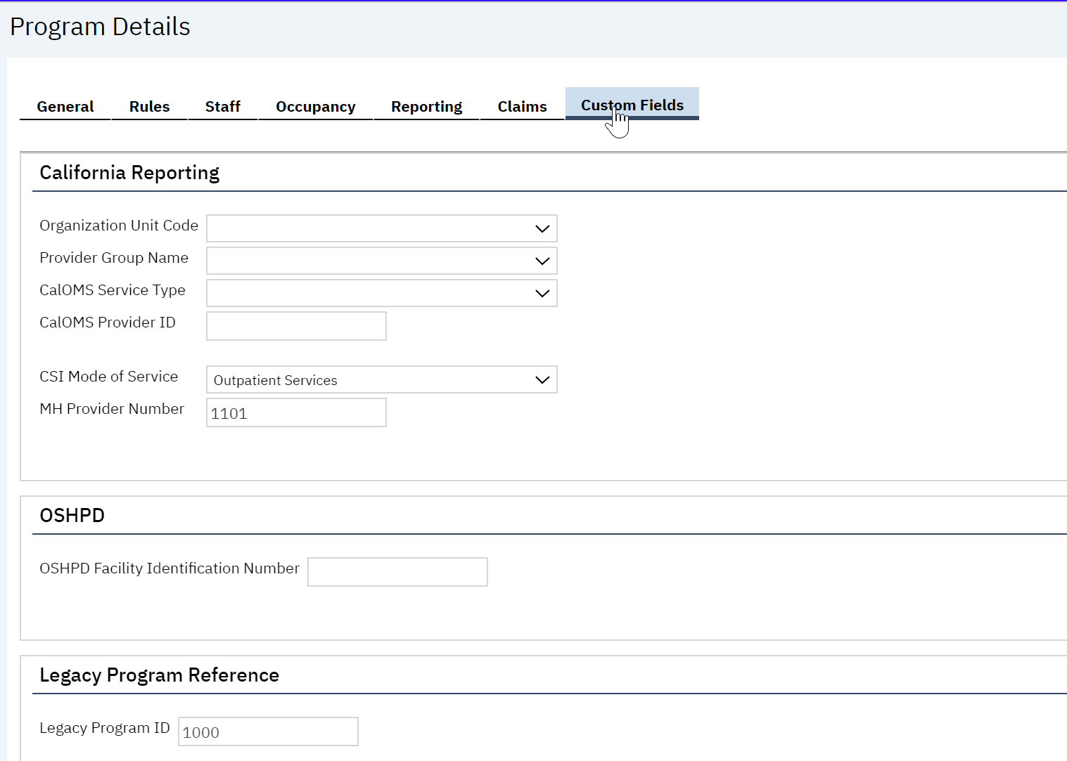
Program Details-Custom Fields
State Reporting program data
Notes:
The important point here is that the complexity of information notices is very different grounded in essential measurable changes in the EMR. Eg network adequacy.

Slide 23
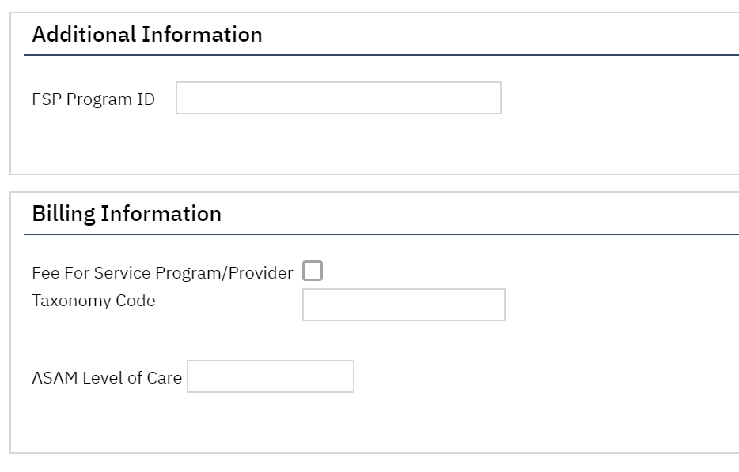
Program Details-Custom Fields
Additional State Reporting program data & Billing Information
FSP Program ID (State Reporting)
FFS Program Identifier (When checked the “FFS” Claim note is added to the 837P Claim)
Taxonomy Code
ASAM Level of Care (This is for the DMC 837I per DHCS companion guide)
Notes:
The important point here is that the complexity of information notices is very different grounded in essential measurable changes in the EMR. Eg network adequacy.

Slide 24
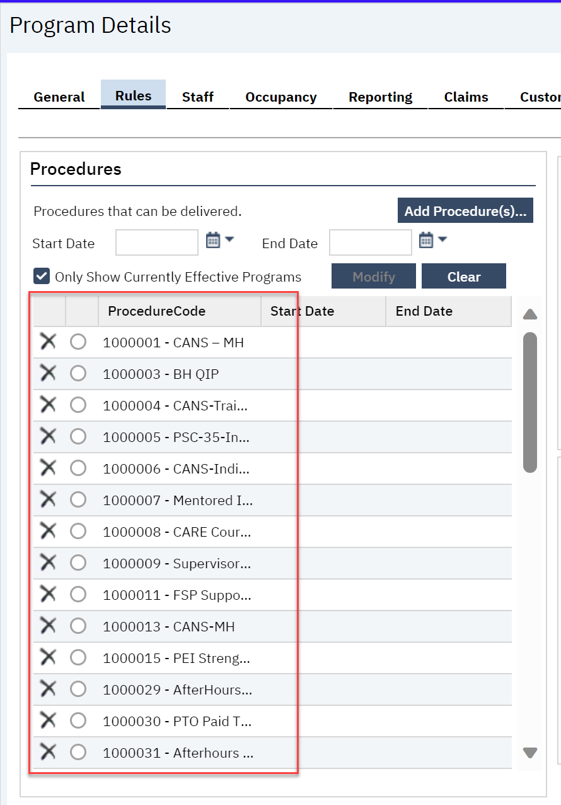
Procedure Codes
Add the procedure codes the program is certified for under the corresponding Service Area

Slide 25
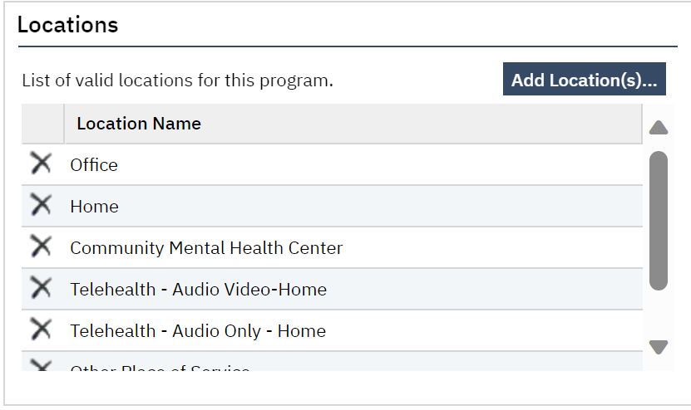
Locations
Add the locations applicable to the program only. Do not add all locations.

Slide 26
Clinical Data Access Grouping (CDAG)
This is a very important step after adding a new program. Once you save your new program, you will not be able to access the program until you add it to the appropriate CDAG group.

Slide 27
Staff/Users
After adding your new program, you will need to grant access to all of the Staff/Users. The users will not be able to see the new program in the dropdown until they have been granted access.

Slide 28
TEDS Setup
If the new program reports CalOMS or CSI, the program will need to be added to the appropriate Episode Type

Slide 29
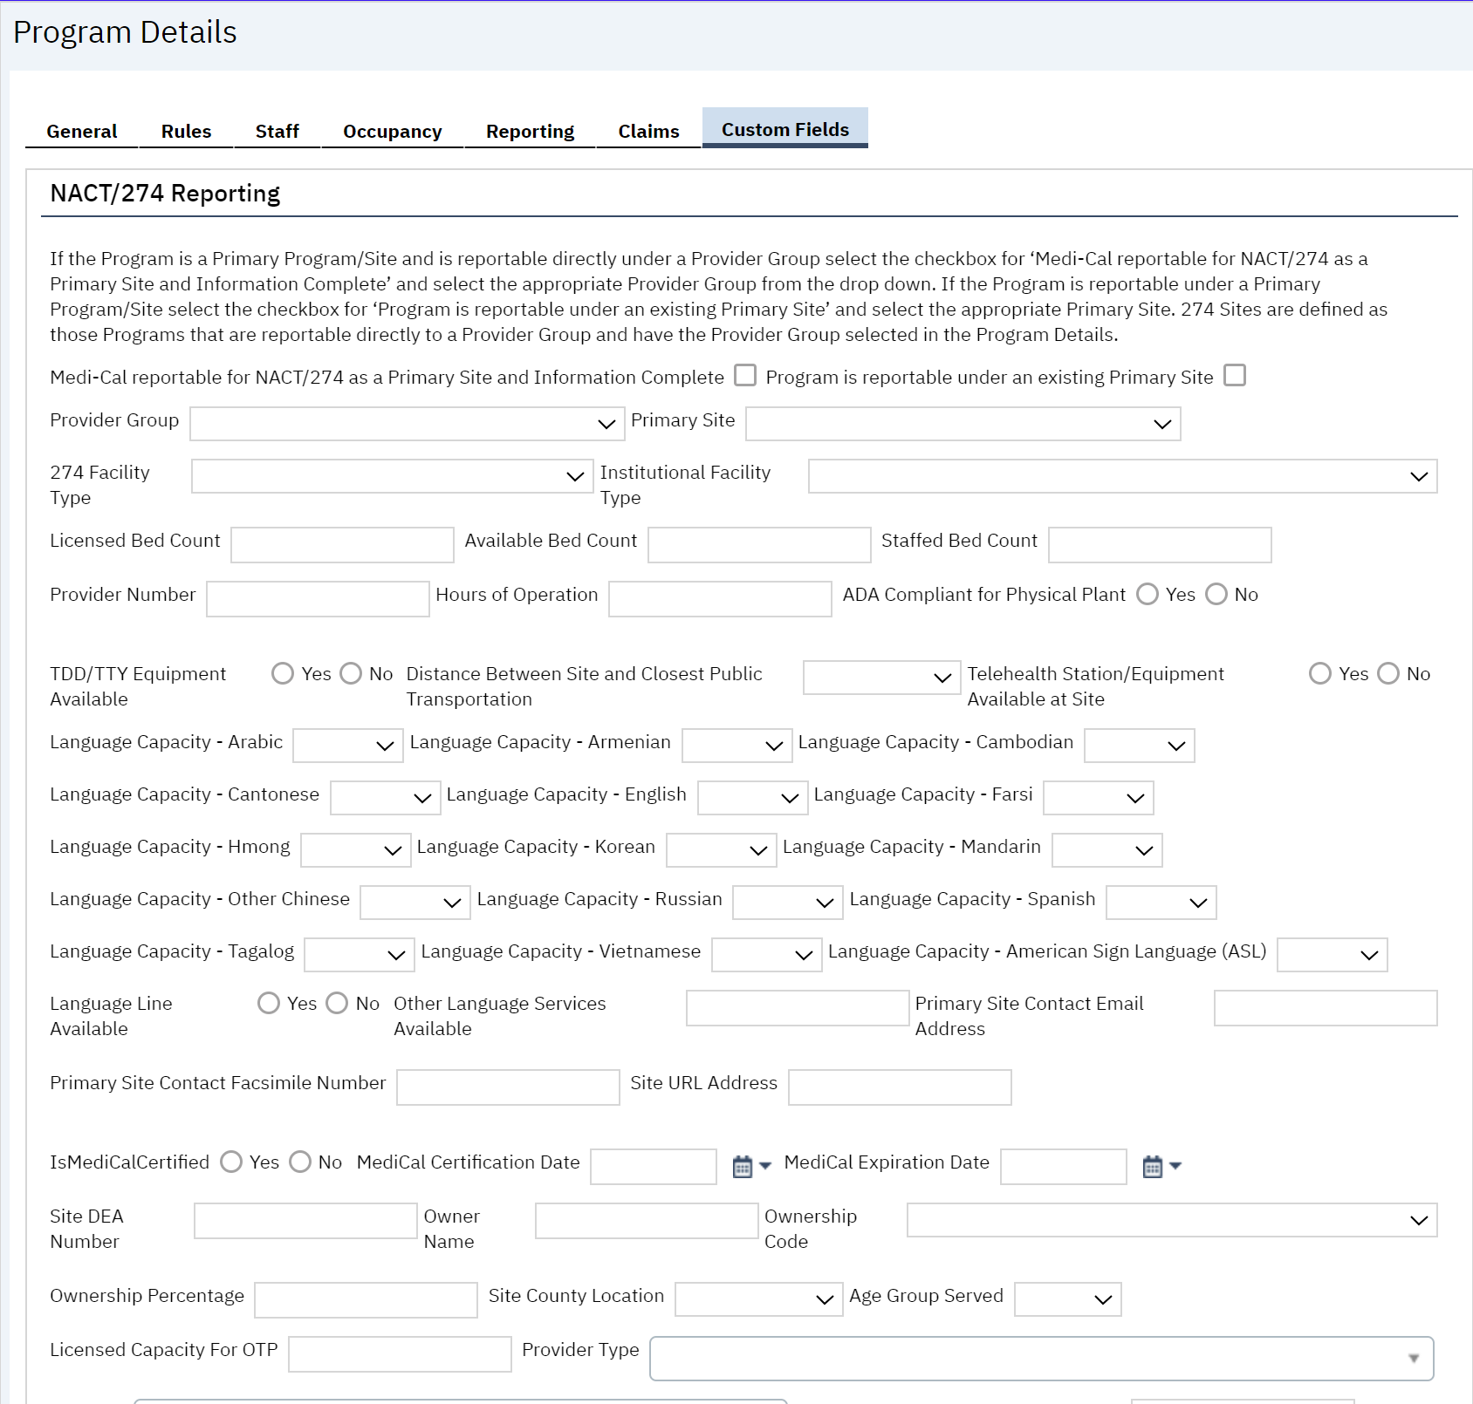
274
If the program is reporting on the monthly 274, this section on the Custom Fields will need to be filled out

Slide 30
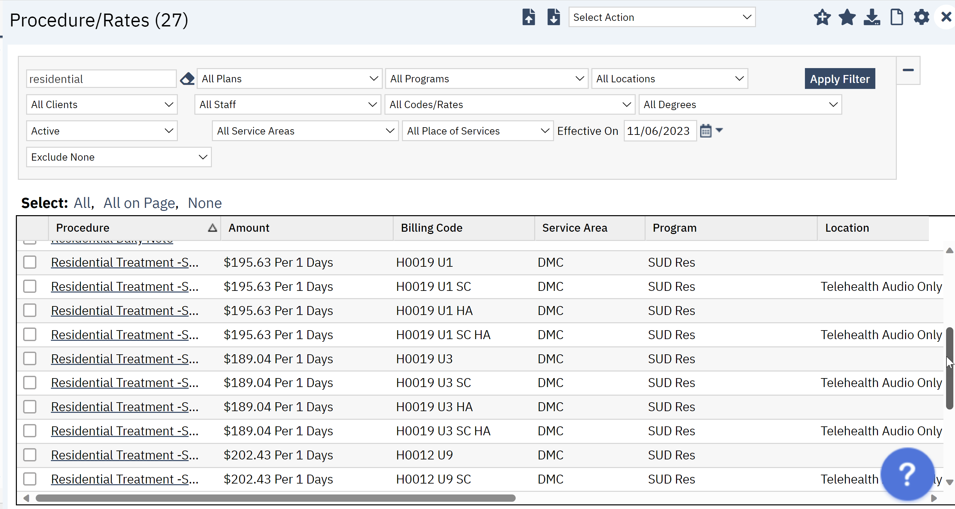
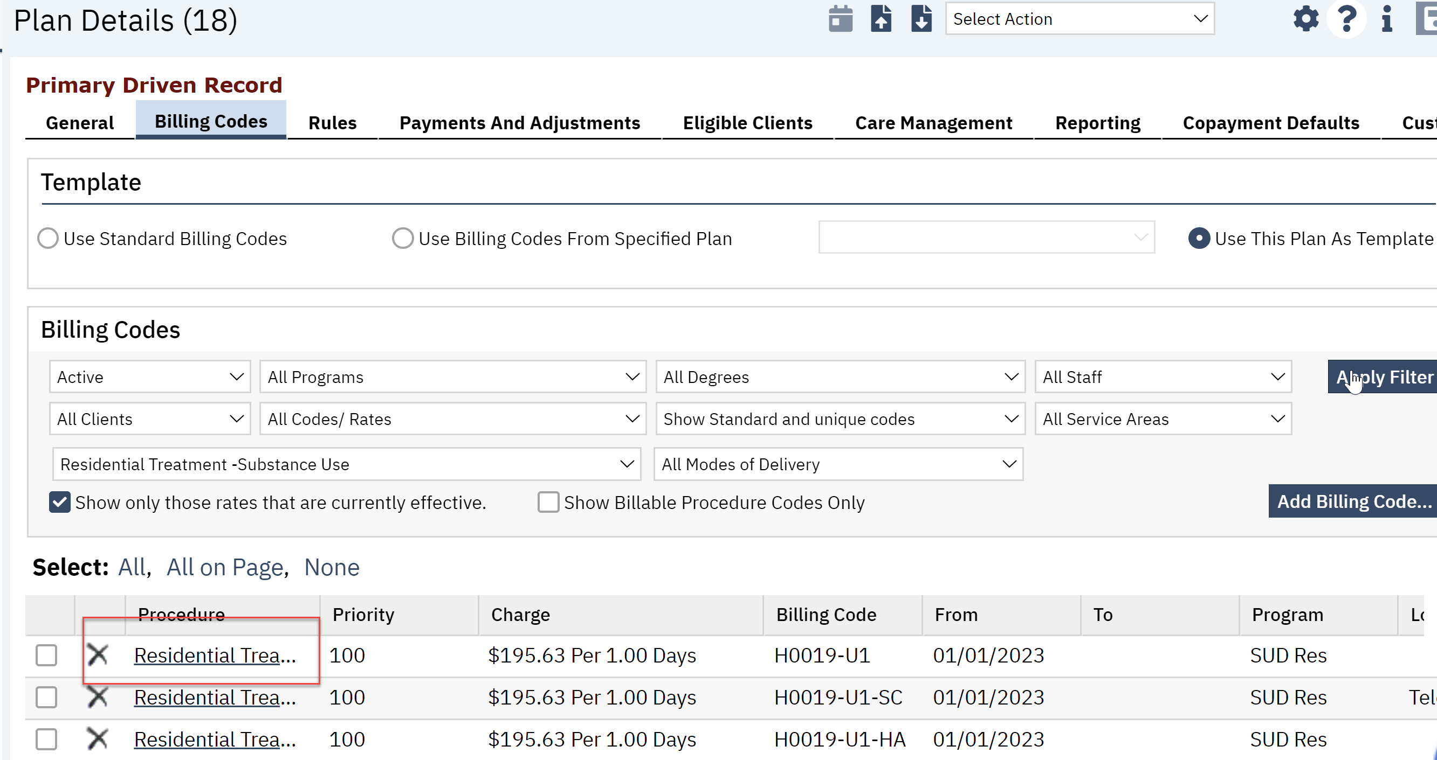
Rates & Billing Codes
When adding a new program, the rates under the Procedure/Rates screen and billing codes setup against the plan will need to be evaluated to determine what will need to be setup for that new program. Generally, a new Mental Health program would not need any additional setup, however, a new Substance Abuse program will require additional setup due to the level of care modifiers. For example: If the new program is a Substance Abuse Residential program, rates will also need the new program added to the appropriate rate for the LOC.

Slide 31
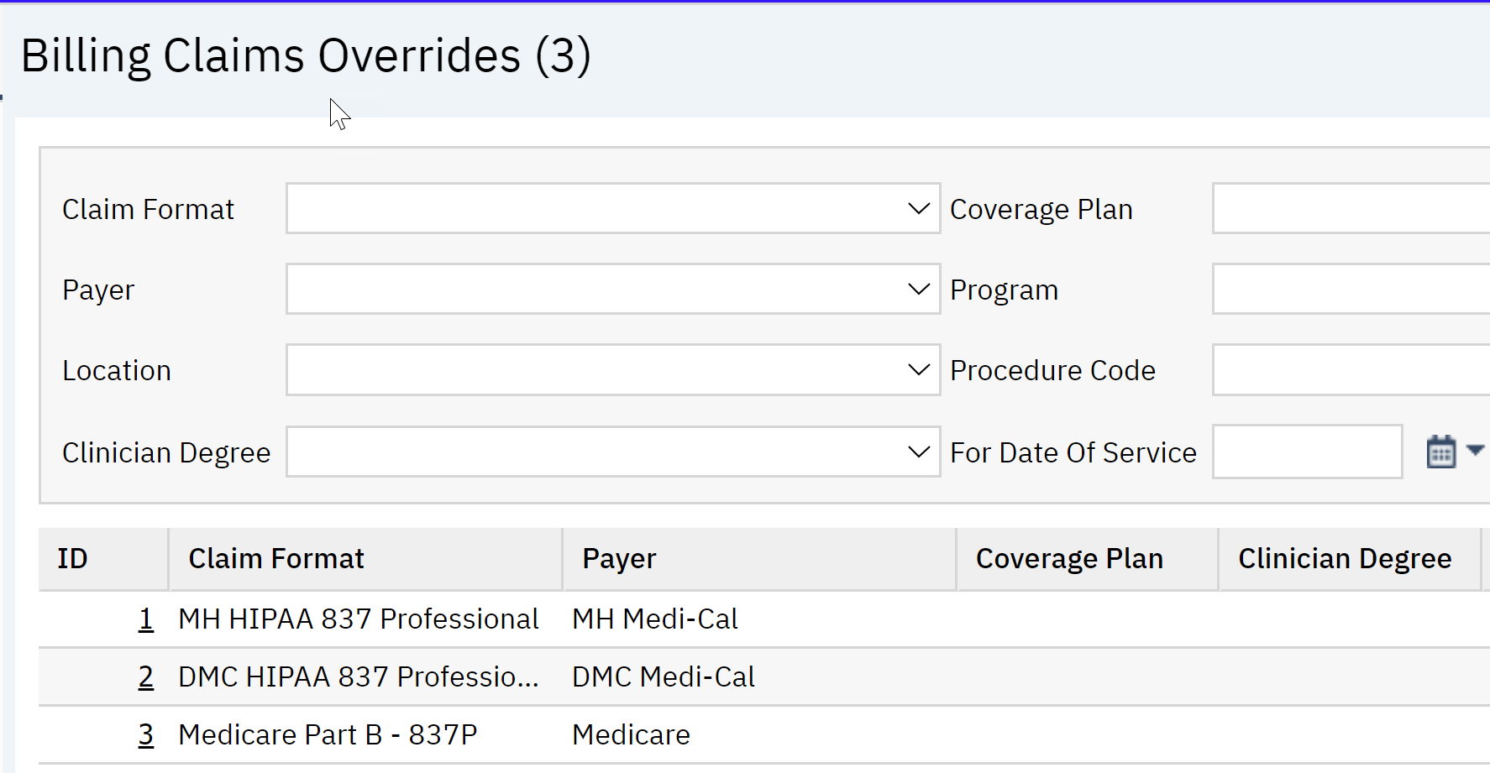
Claim Format/Billing Claims Override
When a new program is added, evaluate if the type of program will need a billing claims override.

Slide 32
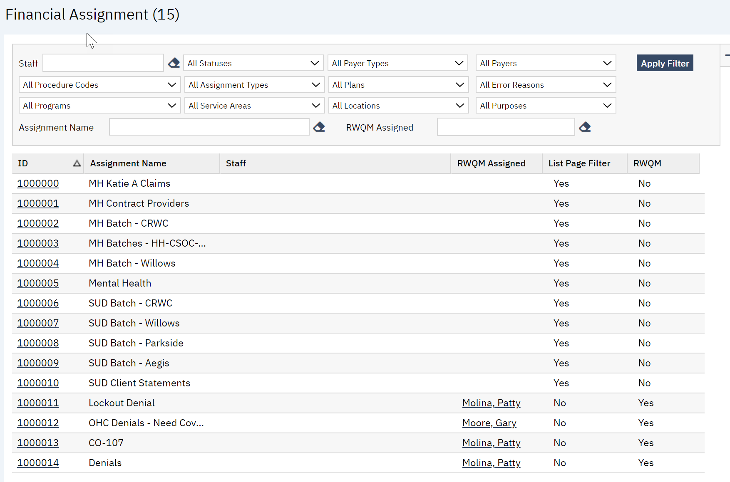
Financial Assignments
Financial Assignments are an excellent tool to use to manage your charges and claims. If you have a new program, need to be added to the appropriate Financial Assignment.

