Slide 1
Billing – Replacement/Void Claims and Delay Reason Codes
CalMHSA Conference – November 2023

Slide 2
Agenda
Introduction(s) and Learning Objectives
Processing Replacement Claims
Processing Void Claims
Delay Reason Codes

Slide 3
Introduction(s) and Learning Objectives
Introductions:
Jennie Brydon, Sr. Billing Business Analyst, Streamline Healthcare and Khristy Stephan, Sr. Implementation Coordinator, CalMHSA
Learning Objectives:
Understand the difference between Rebill, Replacement and Void claims, and how to process each in SmartCare
Learn how to add Delay Reason Codes (DRC) to your claims for billing

Slide 4
Replacement and Void Claims
How to find, mark and process Replacement and Void Claims in SmartCare

Slide 5
Rebill, Replacement and Void Claims
Rebill: A claim has been rejected or was never received by the payer, and needs to be submitted again as an original claim
Replacement: A submitted claim has been corrected, and needs to be resubmitted to the payer
Void: A claim was sent and now needs to be voided in the payer’s system

Slide 6
How to Find Billed Claims
Navigate to the Charges/Claims screen
Set filters, including the “Show billed charges” filter

Slide 7
Marking a Claim Line for Replacement
The easiest way to mark charges that need to be submitted as a replacement claim is to use the “Select Action” menu on the Charges/Claims screen
The action can be used for a single charge, or multiple charges at once
Select the charge(s) an then use the Select Action menu to select “Mark claim line To Be Replaced”

Slide 8
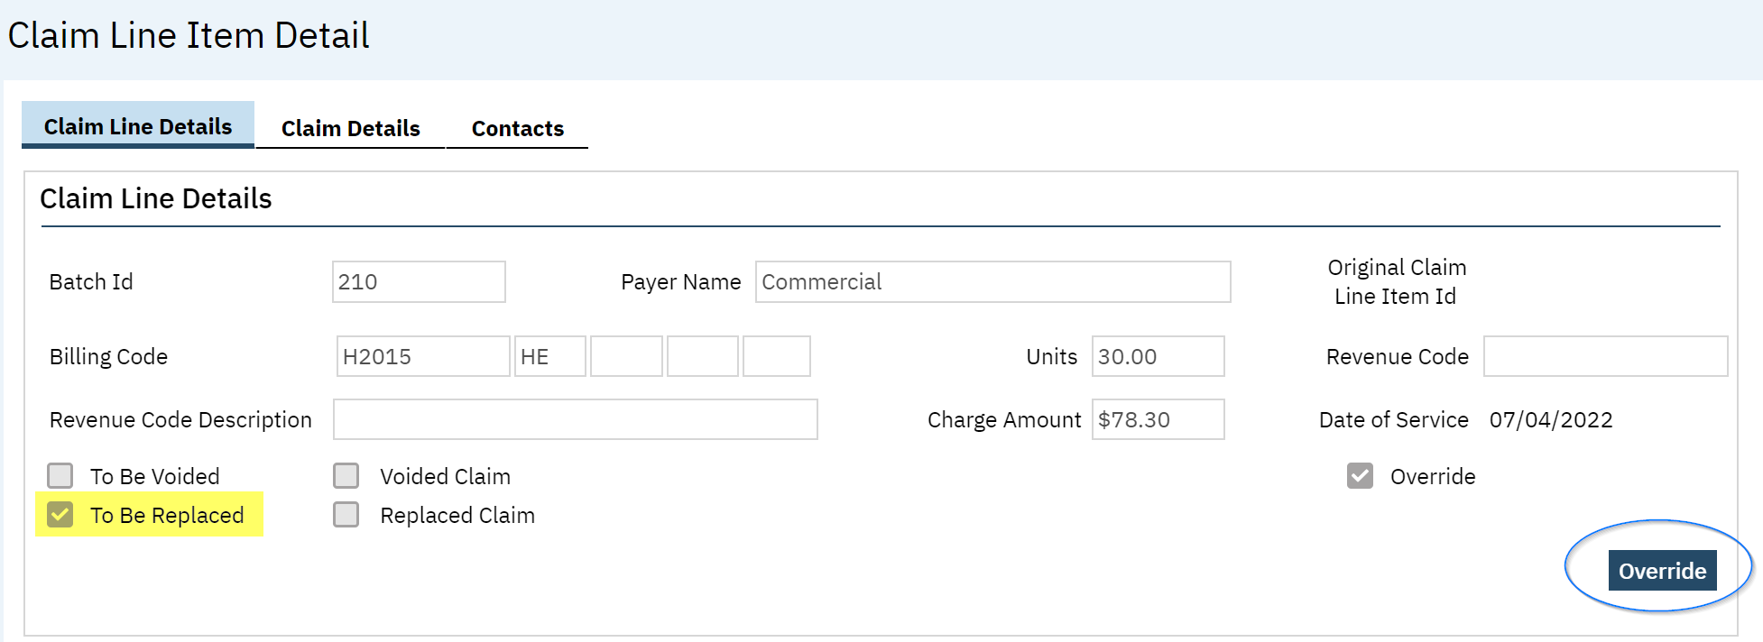
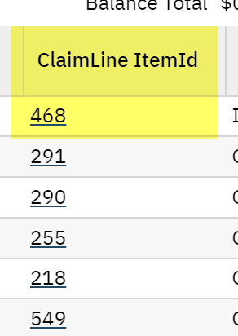
Marking a Claim Line for Replacement: Claim Line Item Detail Screen
A claim line can also be marked as to be replaced via the Claim Line Item Detail screen
To do this, go to the “ClaimLineItemId” column on the Charges/Claims screen and select the claim line hyperlink
Select the blue Override button, select the checkbox for “To Be Replaced” and Save

Slide 9
Marking a Claim Line as a Void
The easiest way to mark charges that need to be submitted as a void claim is to use the “Select Action” menu on the Charges/Claims screen
The action can be used for a single charge, or multiple charges at once
Select the charge(s) an then use the Select Action menu to select “Mark claim line To Be Voided”

Slide 10
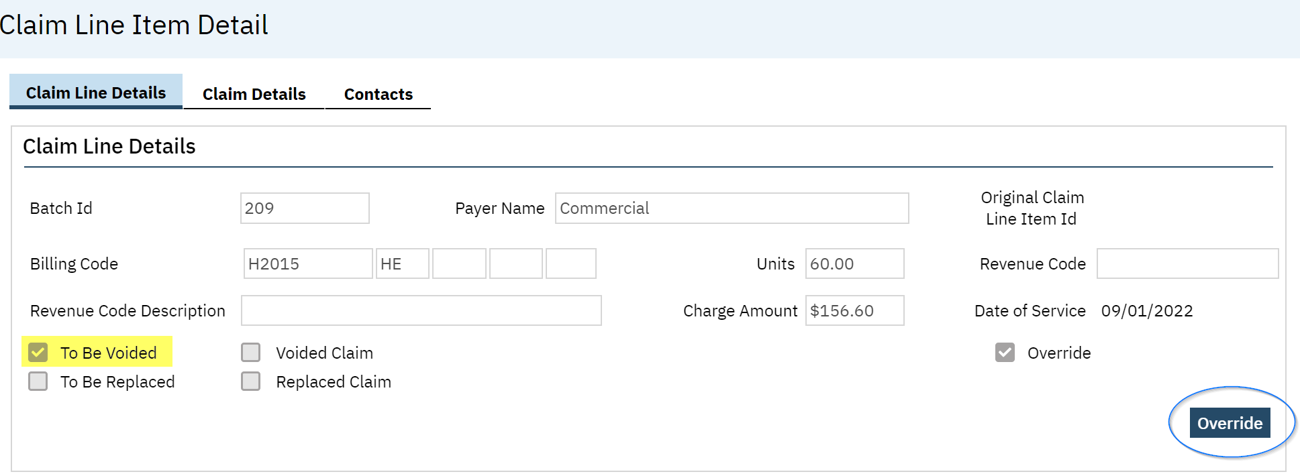
Marking a Claim for Voiding
A claim line can also be marked as to be voided via the Claim Line Item Detail screen
To do this, go to the “ClaimLineItemId” column on the Charges/Claims screen and select the claim line hyperlink
Select the blue Override button, select the checkbox for “To Be Voided” and Save

Slide 11
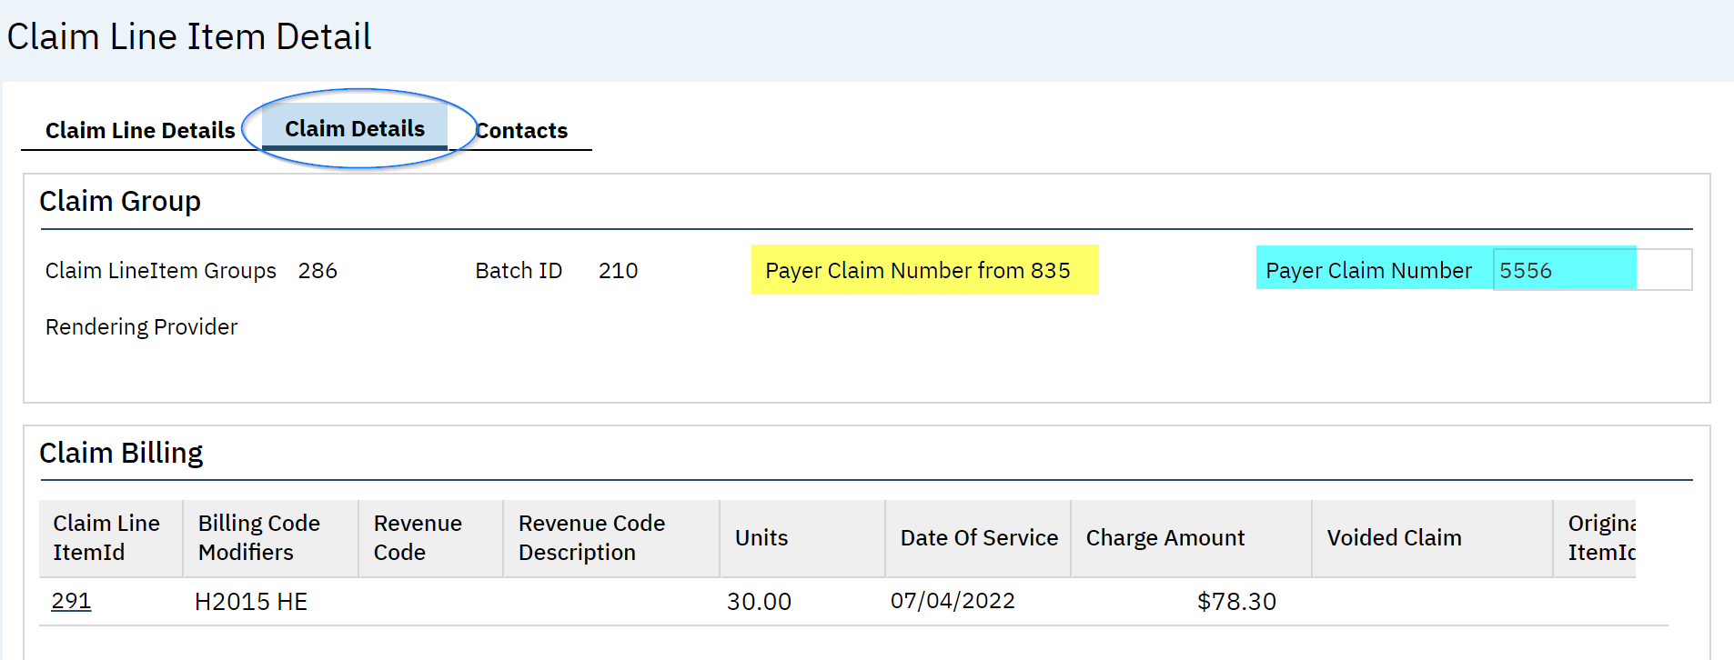
Payer Claim Control Number (PCCN)
When sending a Replacement or Void Claim, the Payer Claim Control Number is required
The PCN will automatically populate when an 835 remit file is processed
For manual payments, the PCN will need to be manually added to the Payer Claim Control Number field

Slide 12
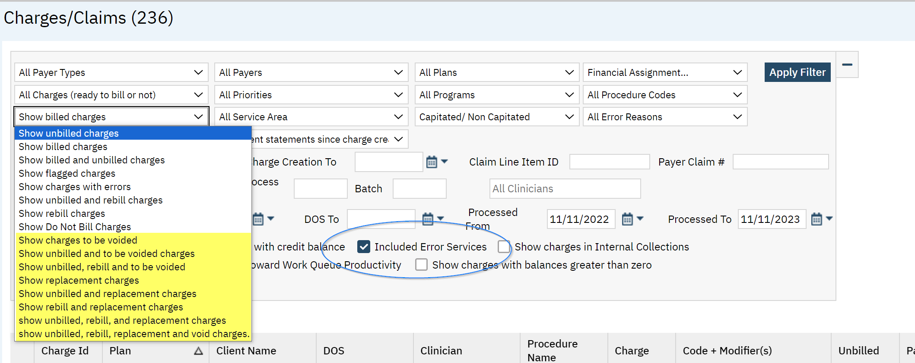
How to Find Replacement and Void Claims
Claim lines that are marked to be Replaced or Voided can be located via the Charges/Claims screen
Set your filter to display Replacement and/or Void Claims
When a Service is marked as an Error, the corresponding Claim Line/Charge will automatically be marked “To Be Voided”
When setting your filters be sure to select the checkbox for “Included Error Services” to find these Claim Lines/Charges

Slide 13
Processing Replacement and Void Claims
When ready to process Replacement and/or Void Claim Lines, run a claims batch via the normal process
SmartCare will automatically insert the correct Frequency Code in the CLM segment of your 837 claim files
7 = Replacement
8 = Void

Slide 14
Delay Reason Codes
How to enter a Delay Reason Code and Supplemental Information in SmartCare for claims submission

Slide 15
Timely Filing Plan Rule (DRC Needed)
A new claim warning will be triggered for services being run in a claims batch after the timely filing limit has been exceeded
The logic for the claim warning will be triggered by:
Program: The program will designate if the service is MH or DMC
MH and DMC services have different timely filing limits for initial claims and replacement claims
Plan: Plan Rules are configured with the specific timely filing limits
A charge error will be created when the Plan Rule is violated
Claims Processing Date and Date of Service:
Using the timely filing guidelines set up in the Plan Rule, SmartCare compares the claims processing date to the date of service, and if it is outside of the timely filing limit specified, the charge error is triggered.
Notes:
Two Rules: One is based on the initial claim submission date and the second on replacement/void claims timely filing

Slide 16
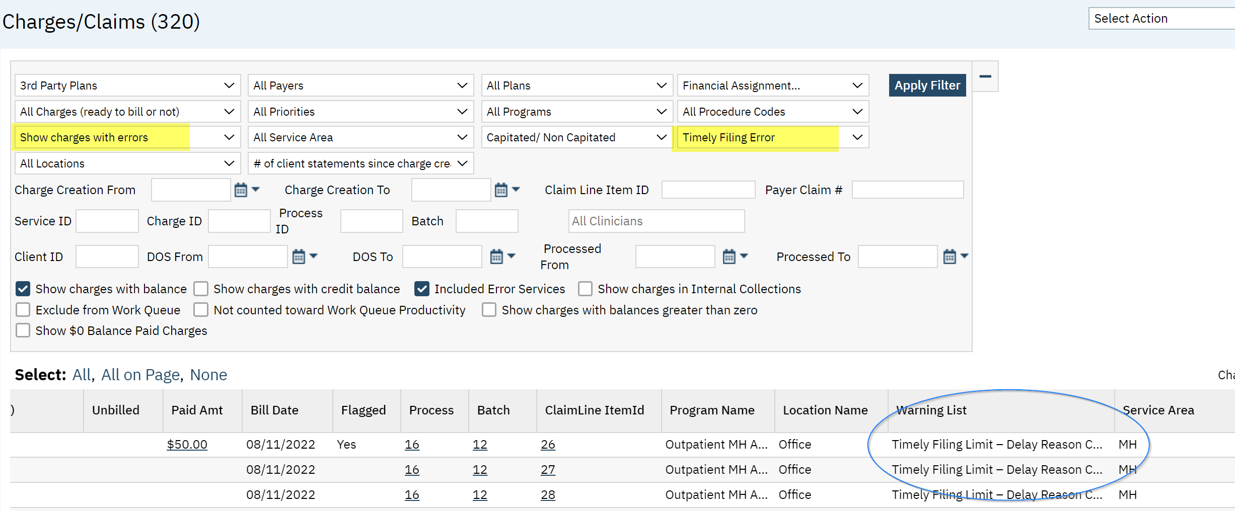
How to Find Timely Filing Charge Errors
Charge Errors can be viewed via the Charges/Claims screen
The filters can be set to isolate only the “Timely Filing Limit – Delay Reason Code Required” error

Slide 17
Adding Delay Reason Codes to Charges
The easiest way to add DRCs to charges is using the Select Action menu via the Charges/Claim screen
Using the checkbox(es), select the charge(s) that require a DRC
Note: Multiple charges can be selected if they all need the same DRC applied
Once selected, use the Select Action dropdown to choose “Add Delay Reason”

Slide 18
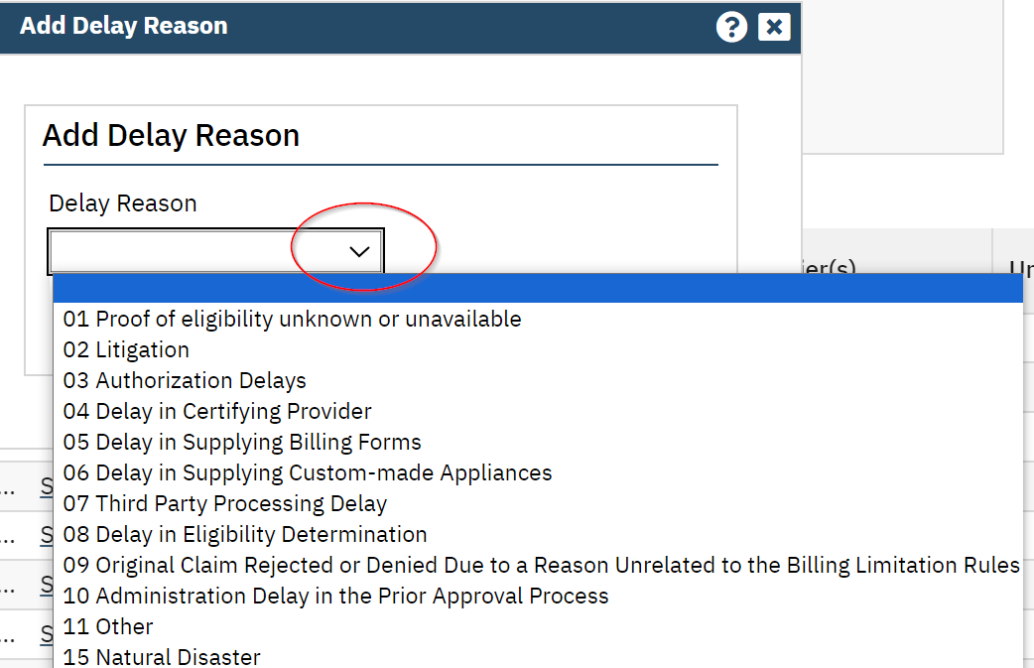
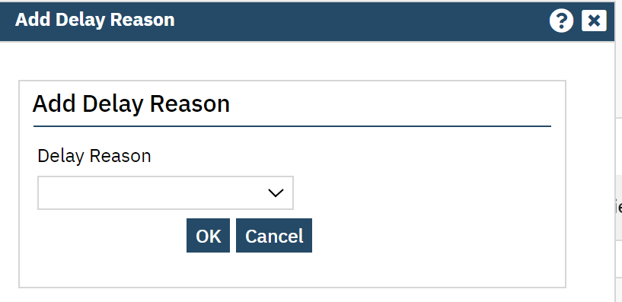
Adding a Delay Reason Code to Charge(s)
When “Add Delay Reason” has been selected via the Select Action menu, a pop-up box will display
Using the dropdown, select the applicable DRC and then click OK

Slide 19
Adding Supplemental Information to Charge(s)
In addition to the DRC, Medi-Cal also requires Supplemental Information also be submitted in the claim file
MedCCC will provide a DRC Control Identifier Number that gets reported in the PKW segment
To add this information, use the checkbox(es) to select the applicable charges, and then via the Select Action menu select “Add Supplemental Information”
Note: Multiple charges can be selected if they all need the same DRC Control Identifier Number

Slide 20
Adding Supplemental Information to Charge(s)
Once “Add Supplemental Information” has been selected from the Select Action menu, a pop-up box will display
Enter the MedCCC provided DRC Control Identifier Number in the ID field
For the Type field, using the dropdown, select “CT-Support data for Delay Reason Code”
“EM” should be selected for the Transmission Code
These three pieces of data make up the PWK segment in the claim file

Slide 21
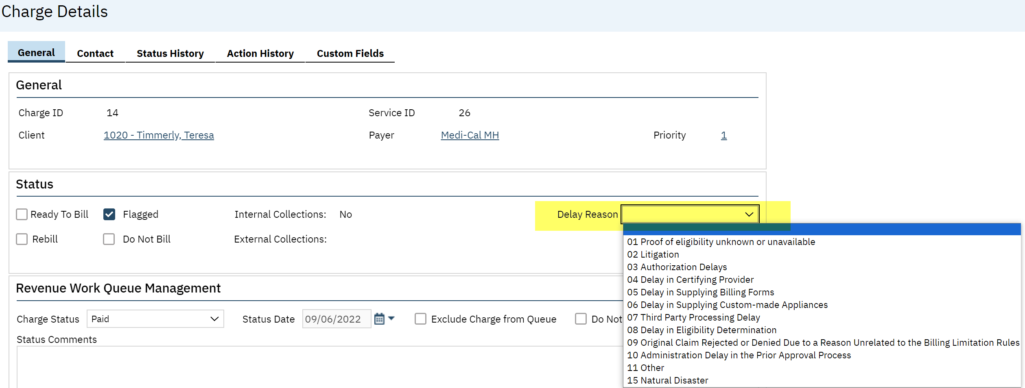
Adding/Editing a DRC via Charge Details
A Delay Reason Code can also be added via the Charge Details screen
The field is located on the General tab in the “Status” section
Use the dropdown menu to select or edit the DRC and then Save

Slide 22
Adding/Editing Supplemental Information via Charge Details
Supplemental Information can also be added via the Charge Details screen
The field is located on the General tab in the “Status” section
Use the dropdown menu to select or edit the DRC and then Save

Slide 23
Claims Processing with DRC and Supplemental Information
Once the DRC and Supplement Information has been added to the Claim Line, the charge error will still be present; there are two ways to clear the error:
The overnight billing job will clear the error and mark the charge as Ready to Bill
The Ready to Bill checkbox can manually be selected in the Charge Details screen, or the Select Action menu can be used on the Charges/Claims screen
Run the charge(s) in a claims batch like normal
The DRC will populate in the CLM segment and the Supplemental Information will populate in the PWK segment

Slide 24
Bonus Slides
Additional information to help you manage your claims better

Slide 25
Services Marked as Error = To Be Voided
Once a service has moved to a “Complete” status, a charge is generated and ultimately billed
If a service is marked as an “Error,” the system will automatically mark the charge as “To Be Voided”
These charges must be run in a batch to send to Medi-Cal
To locate the charges to be voided in SmartCare, navigate to the Charges/Claims screen and filter for them
Remember to select the “Included Error Services” checkbox

Slide 26
Filters and Favorites
There’s no question there is a lot to keep track of when it comes to billing and the Charges/Claims screen in SmartCare
Setting Favorites can help you quickly filter charges, and streamline your workflows
The steps are quick and easy:
Set your filters as needed and select the Apply Filter button
On the toolbar, Select the Star+ icon to create a New Favorite
At the Favorite Pop Up, name your new Favorite, set any additional desired criteria and click Ok
Relative vs Static – You can set dates to always stay the same (Static) or be change based on criteria entered (Relative)
To locate SmartCare’s Date/Time Language, click on any calendar icon in the system, at the bottom you will see some of the shortcuts with a “more” hyperlink.
To use your Favorites, hover over the plain Star icon on the toolbar, and select the Favorite, or type the name of your Favorite in the Search and select the hyperlink for it (this can be done from any screen in SmartCare)

Slide 27
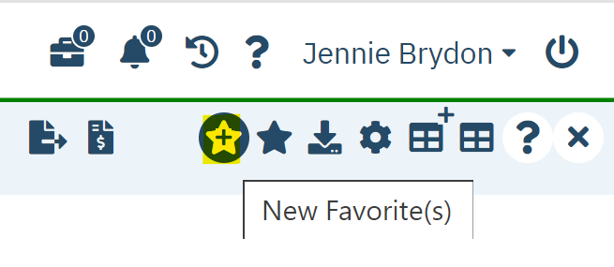
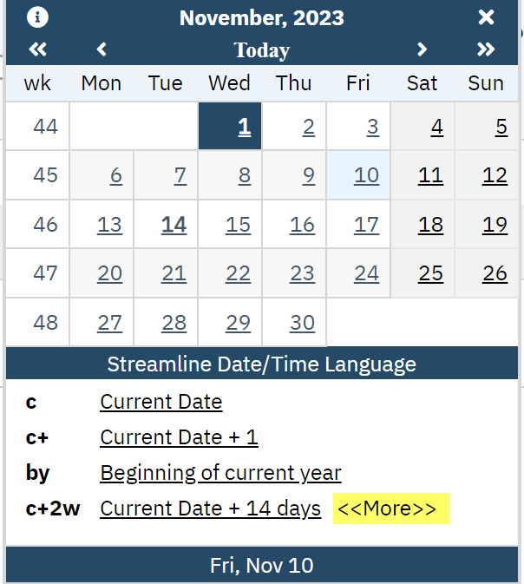
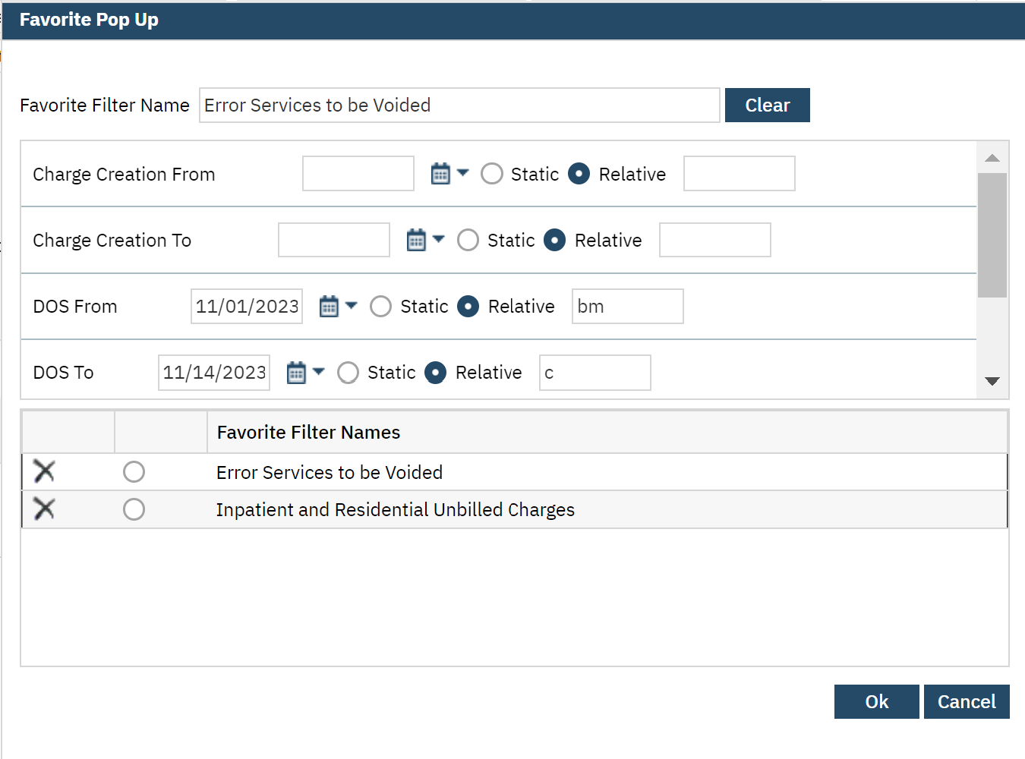
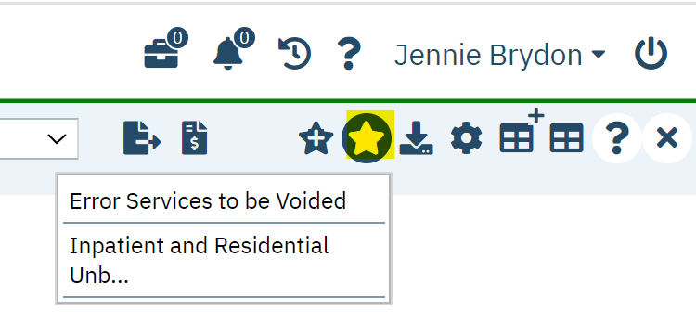
Filters and Favorites
1.
2.
3.
4.

Slide 28
Charge Error – “Missing PCCN”
Replacement and Void claims both require the PCCN be submitted for each charge in the claim file
If the PCCN has not been entered either via the 835 processing or manually, a claim error will generate
To correct this claim error:
Select the ChargeId hyperlink to open the Charge Details screen
On the General tab, scroll to the “Billing History” section
Click on the ClaimLine Item Id hyperlink to open the Claim Line Item Detail screen
Select the Claim Details tab
Enter the PCCN and Save
Once completed, return to the Charges/Claims screen and run your claims batch again

Slide 29
Conclusion
Learning recap, questions and THANK YOU!

Slide 30
Learning Recap
The difference between a Rebill, Replacement and Void claim in SmartCare
How to mark claim lines as needing To Be Replaced or Voided
How to find claim lines that are marked as To Be Replaced or Voided
Processing Replacement and Void claims
Plan Rules for Timely Filing
How to add/edit Delay Reason Codes to claim lines
How to add/edit Supplement Information to charges
Processing claims with DRCs and Supplemental Information

Slide 31
Questions
Questions?
Parking lot items will be answered and sent out to the counties

Slide 32
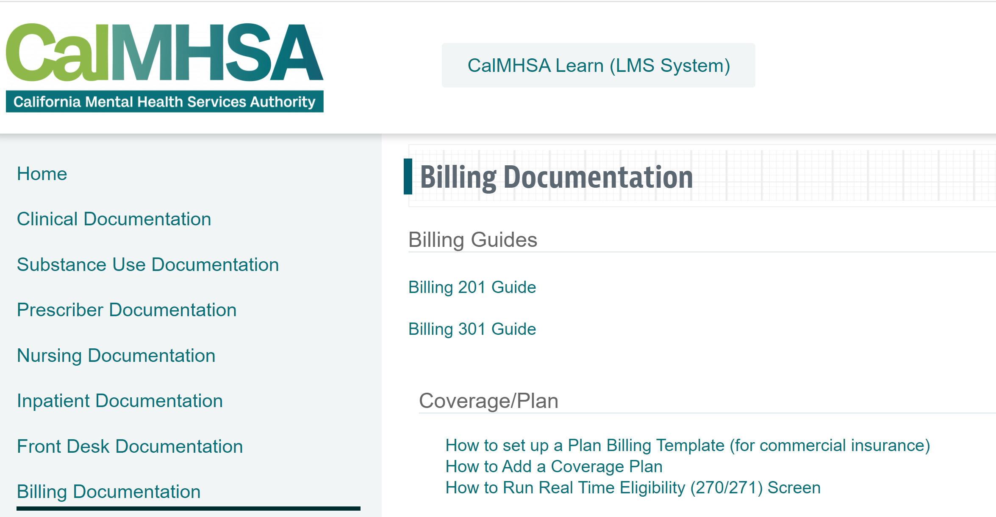
Thank you!
This presentation will be made available for reference on the CalMHSA Training website on Friday
https://2023.calmhsa.org/

