Slide 1
Conversion to SmartCare – An Overview

Slide 2
Conversion Lab 1 - Overview
What is Conversion?
The process of taking carefully selected data from your existing EHR and bringing it into SmartCare in a way that will allow your users to see what they expect the first day they log in to the new EHR.
Goal: The transition between the two EHR’s to be as seamless as possible.
Discussion Today:
Overall understanding of the conversion process
Who needs to be involved – Who needs to make decisions
Another look at the process
2

Slide 3
Conversion Lab 1 - Overview
True of False, CalMHSA has our back and will do 100% of the conversion for us?
False.
Each county must actively engage in this conversion process in a way where they fully understand the implications of the decisions they are making.
What decisions will we need to make?
System Setup – Procedures / Programs
Staff Setup – Staff configurations – define roles and access to workflows ( forms / screens etc.)
Client Setup
Which clients
Diagnosis records
Etc.
State Reporting data
Continuity of care documents (PDF’s available in SmartCare that provide historical reference for your clients)
These must be designed by the counties for use by their users
3

Slide 4
Conversion Lab 1 - Overview
True of False, conversion is mainly an IT process?
False.
The important concepts that must be understood are mainly related to EHR management staff.
It’s true that the movement of the data from one EHR to another is largely an IT process.
However, the data inside the csv files being moved is best understood by those people who manage the EHR day in and day out.
4

Slide 5
Conversion Lab 1 - Overview
How will CalMHSA assist us in the conversion process?
Guide the counties through the process
Provide recommendations for what data will be useful to bring (final decision still belongs to county)
Evaluate / pre-process your data extract files
Provide feedback on quality of data files extracted from existing EHR
Provide insight into conversion file errors so that each county can fix their extract process
Facilitate conversion schedules between counties and Streamline
Explain the data mapping in the conversion for csv files
Provide updates on overall conversion process
5

Slide 6
Conversion Lab 1 - Overview
Conversion is not data archiving
Conversion is this process of transitioning from your existing EHR to SmartCare
Carefully selected data to allow for a smooth transition between EHR’s
Archiving is the process of saving your important historical data for record retention purposes.
Audits, Cost Reporting, CMS interoperability requirements etc.
Minimize overlap and double paying for EHR’s
Current EHR
Conversion Data
All other historical Data
Smart Care EHR
Archive DB
6

Slide 7
Conversion Lab 1 - Overview
Conversion is not data archiving?
This process and this conversation is focused on Conversion
Current EHR
Conversion Data
All other historical Data
Smart Care EHR
Archive DB
7

Slide 8
Conversion Lab 1 - Overview
What is the process?
Three rounds of conversions for testing YOUR data files
We are not testing the SmartCare conversion process – we know it works
We are testing your data extracts. As such we need to test with REAL production data.
We can not test with 100 clients and then at go live try to upload 20,000 clients. (huge risk)
With each round we need to work with full extracts for the conversion files being tested
AT GO LIVE :
We will not be adding files that have not been fully tested.
We will not be accepting conversion files with significant changes/additions
If you have not tested a conversion file, it will not be loaded (manual updates)
Get organized early
8

Slide 9
Conversion Lab 1 - Overview
What do counties need to do prior to round 1
Identify the scope of your conversion
Identify your conversion team
Review all SmartCare conversion spreadsheets and instructions
Be familiar with the best practices material from CalMHSA
Assure that you have proper access to the source data in your current EHR
More?
NO new conversion file types will be added to the process after round 2
9

Slide 10
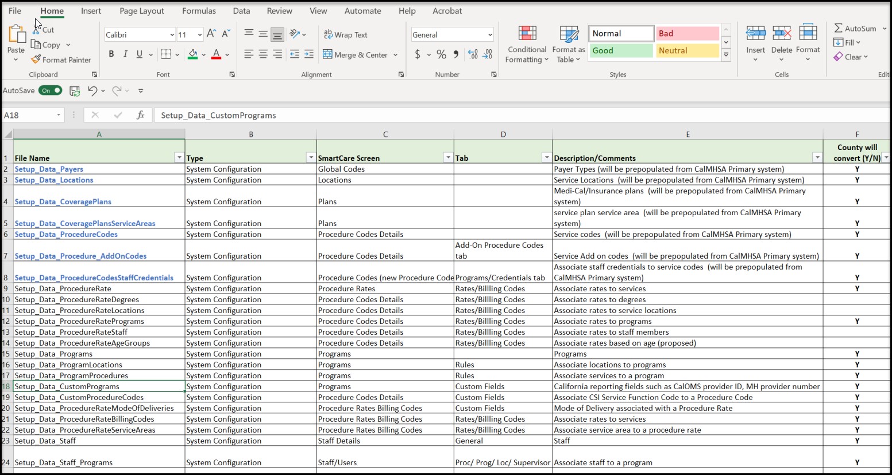
Conversion Lab 1 - Overview
What does “scope of conversion” mean
What type of data will be brought into SmartCare from your current EHR
Specifically, which “rows” of data for each “type of data” will be brought to SmartCare.
10

Slide 11
Conversion Lab 1 - Overview
Why so many files?
The Streamline conversion process is designed so that each csv file provided will insert data into one and only one table.
The conversion process depends on having csv files loaded in a specific order.
“you can’t insert a client address if the client ID does not already exist”
11

Slide 12
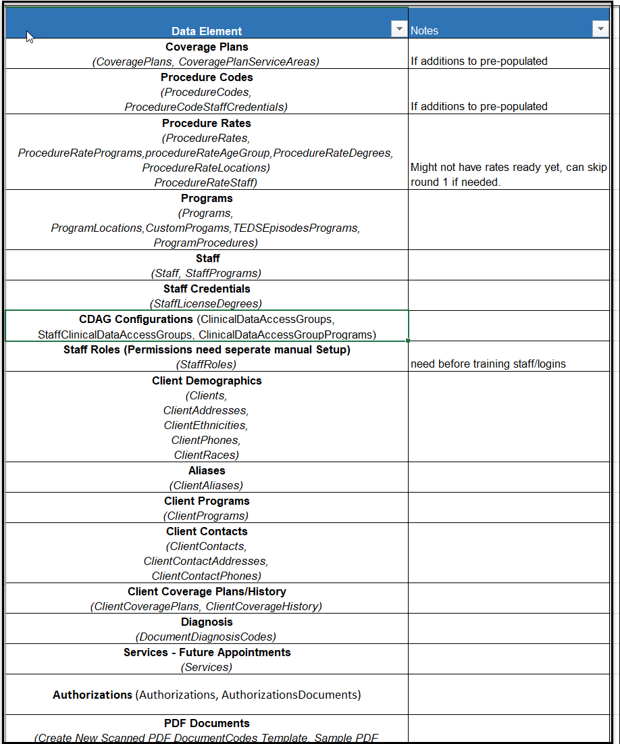
Conversion Lab 1 - Overview
Order of conversion – or conversion precedence
Once the scope has been determined, this Data Migration Tracker file can be produced.
12

Slide 13
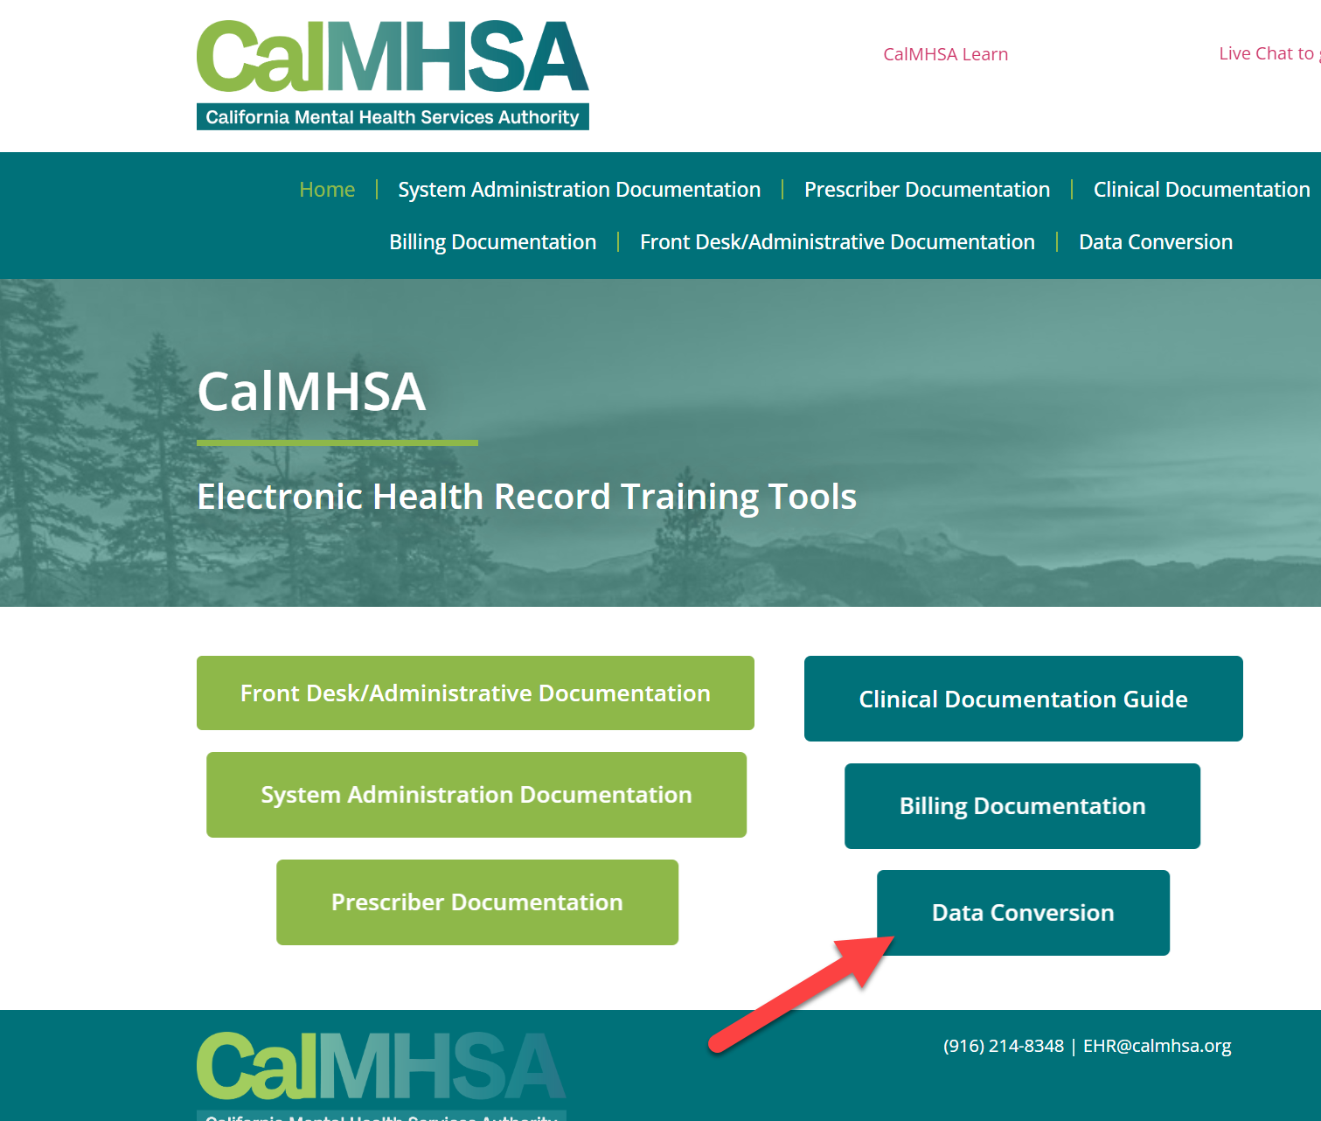
Conversion Lab 1 - Overview
A highly detailed project requiring a lot of preparation, communication and patience
By March 10 we will have the most up to date info on 2023.CalMHSA.org under the conversion button.
13

Slide 14
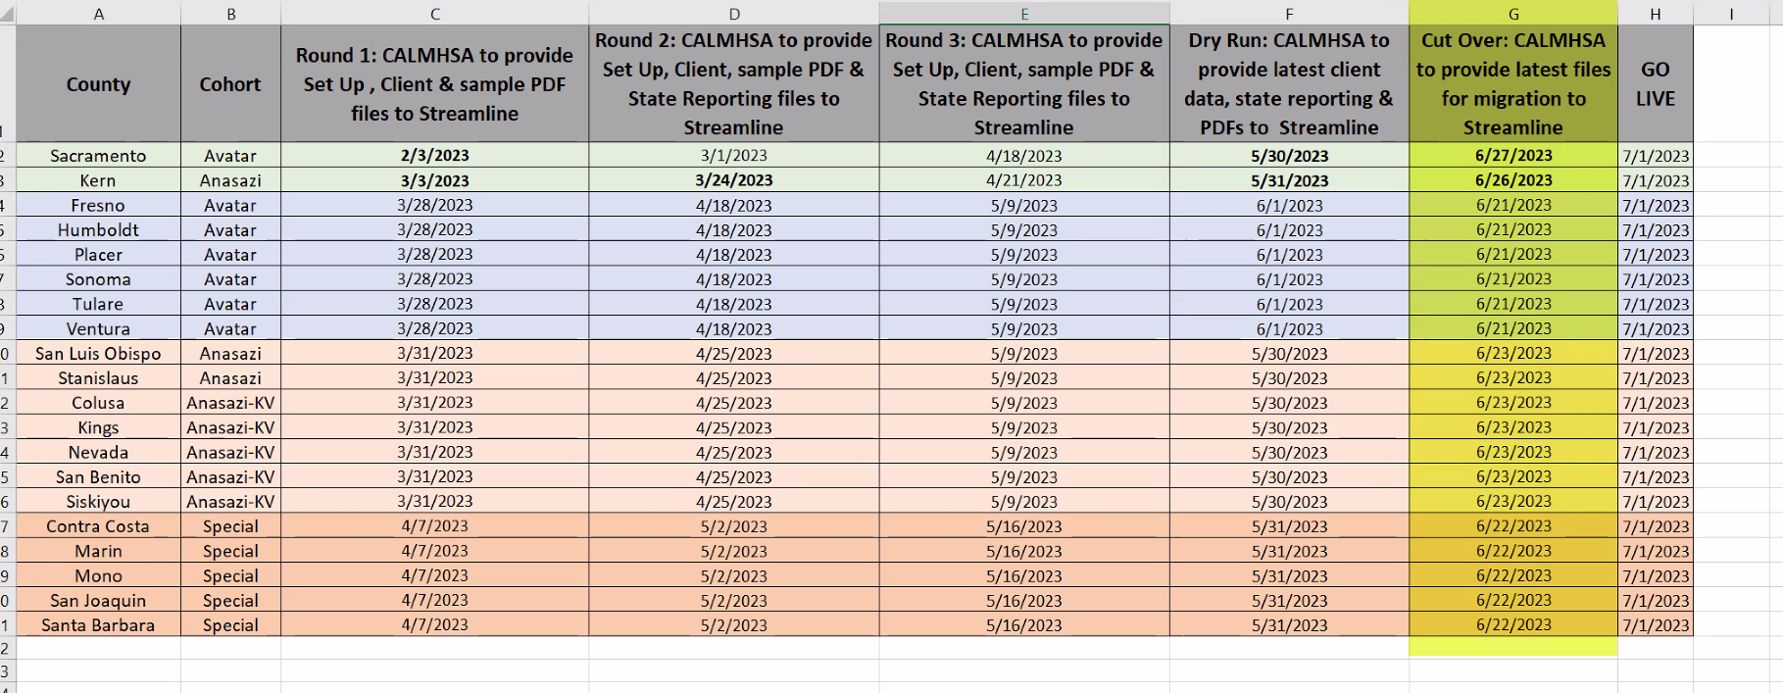
Conversion Lab 1 - Overview
Conversion Schedule :
14

Slide 15
Conversion Lab 1 - Overview
QUESTOINS ?
15

